Slide 1
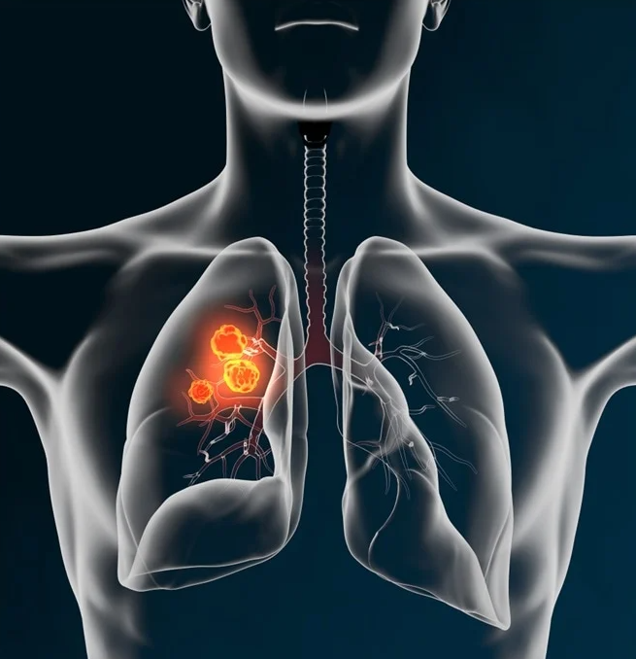

Awareness of
Lung Cancer
0
GCMA - PP-UNP-IND-0251 5th Jan 2024

Slide 2

Contents
Burden of Disease- Global and India
Etiology
Types of lung cancer

Slide 3
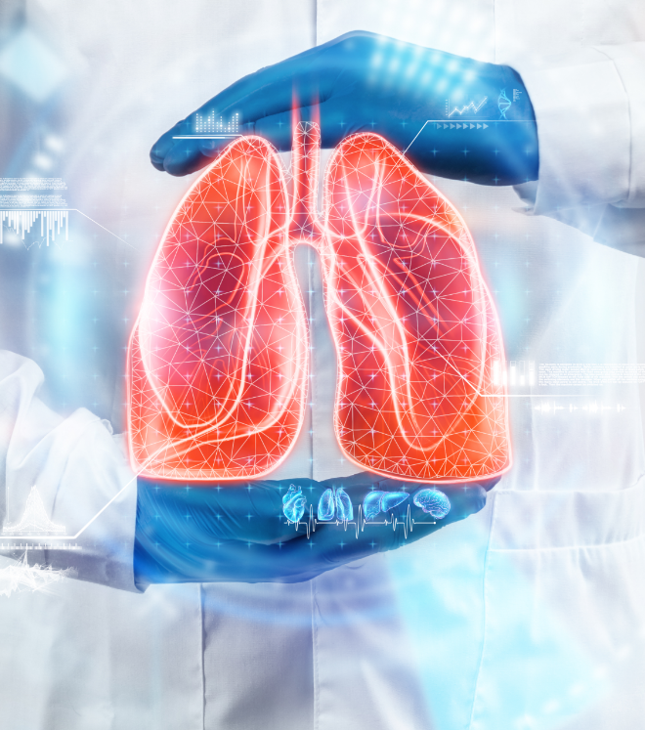


Burden of Cancer- Global and India
v
Global cancer burden
has risen to 19.3 million cases and 10 million cancer deaths in 2020.¹
According to International Agency for Research on Cancer (IARC):¹
Globally 1 in 5 people develop cancer during their lifetime
1 in 8 men and 1 in 11 women die from the disease
More than 50 million people are living within 5 years of a past cancer diagnosis
1. GLOBOCAN 2020: New Global Cancer Data. https://www.uicc.org/news/globocan-2020-new-global-cancer-data#:~:text=GLOBOCAN%202020%20is%20an%20online,for%20all%20cancer%20sites%20
combined. Access Date: Nov 1, 2023

Slide 4








Estimated number of new cancer cases in 2020, worldwide
Females, all ages¹
Total : 9,227,484
Breast
Colorectum
Lung
Cervix uteri
Thyroid
Corpus uteri
Stomach
Other Cancers
2,261,419
(24.5%)
865,630
(9.4%)
770,828
(8.4%)
604,127
(6.5%)
448,915
(4.9%)
417,367
(4.5%)
369,580
(4%)
3,489,618
(37.8%)
`
Among females, lung cancer is the third most diagnosed cancer after breast cancer and
colorectal cancer.
1. GLOBOCAN 2020: New Global Cancer Data. https://www.uicc.org/news/globocan-2020-new-global-cancer-data#:~:text=GLOBOCAN%202020%20is%20an%20online,for%20all%20cancer%20sites%20
combined. Access Date: Nov 1, 2023

Slide 5




Estimated number of new cancer cases in 2020, worldwide
Males, all ages¹
Total : 10,065,305
Lung
Prostate
Colorectum
Stomach
Liver
Bladder
Oesophagus
Other Cancers
1,435,943
(14.3%)
1,414,259
(14.1%)
1,065,960
(10.6%)
719,523,
(7.1%)
632,320
(6.3%)
440,864
(4.4%)
418,350
(4.2%)
3,938,086
(39.1%)
`
Lung cancer and prostate cancer are the most common among men, together accounting for nearly one-third of all male cancers.
1. GLOBOCAN 2020: New Global Cancer Data. https://www.uicc.org/news/globocan-2020-new-global-cancer-data#:~:text=GLOBOCAN%202020%20is%20an%20online,for%20all%20cancer%20sites%20
combined. Access Date: Nov 1, 2023

Slide 6

However, Lung cancer remains the leading cause of cancer deaths in both sexes and all ages. ¹
Number of deaths in 2020, both sexes, all ages
Total : 9,958, 133 deaths
Lung
Colorectum
Liver
Stomach
Breast
Oesophagus
Pancreas
Prostate
1,796,144
(18%)
935,173
(9.4%)
830,180
(8.3%)
768,793
(7.7%)
684,996
(6.9%)
544,076
(5.5%)
466,003
(4.7%)
375,304
(3.8%)
Other Cancers
3,557,464 (35.7%)
1. All cancers.Source Globocan 2020. Available from https://gco.iarc.fr/today/data/factsheets/cancers/39-All-cancers-fact-sheet.pdf [Accessed on January 2024]

Slide 7






Lung Cancer - Global
Highest mortality among
36 cancer types considered.^{1,2}
1st most diagnosed cancer type among men
and 2nd most among women.^{1,2}
Mortality is associated with
later stages of malignancy
and late diagnosis.^{3,4,7}
In 2020, based on data from 185 countries,
the approximate number of diagnosed cases
was estimated at 2,206,771 (11.4% of all
cancers), while mortality was
1,796,144 (18.0%).²
During the 1980s in the US, the
lung cancer incidence level reached
a plateau for men and has steadily
declined.⁵ However, the growing
number of cases in women is
alarming.^{3,6}
1. Bray F. et al. Global cancer statistics 2018. CA Cancer J. Clin. 2018;68:394–424. doi: 10.3322/caac.21492. 2. Sung H. et al. Global Cancer Statistics 2020. CA Cancer J. Clin. 2021;71:209–249. doi: 10.3322/caac.21660.
3. Meza R. et al. Lung cancer trends in the United States, 1973-2010. PLoS ONE. 2015;10:e0121323. doi: 10.1371/journal.pone.0121323. 4. Chen V.W. et al. Stage and clinical factors for lung cancer. Cancer. 2014;120:3781–3792. doi: 10.1002/cncr.29045. 5. Thun M.J. et al. 50-Year trends in smoking-related mortality in the US. N. Engl. J. Med. 2013;368:351–364. doi: 10.1056/NEJMsa1211127. 6. Lortet-Tieulent J. et al. Convergence of tobacco-related cancer rates in Europe, 1988–2010. Eur. J. Cancer. 2015;51:1144–1163. doi: 10.1016/j.ejca.2013.10.014. 7. He, Siyi et al. “Survival of 7,311 lung cancer patients by pathological stage and histological classification: a multicenter hospital-based study in China.” Translational lung cancer research vol. 11,8 (2022): 1591-1605. doi:10.21037/tlcr-22-240

Slide 8

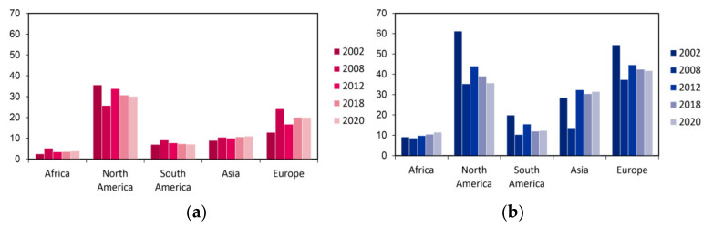
Lung Cancer - Global
Adapted from Rodak O et al. (2021). Non-Small Cell Lung Cancer: Epidemiology, Classification, Therapies. Cancers (Basel), 13(18), 4705. doi: [DOI]. PMID: 34572931.
The number of people diagnosed with lung cancer per 100,000 inhabitants. (a) Incidence among women concerning world regions in 2002–2020; (b) Incidence among men concerning world regions in 2002–2020. ¹
1. Rodak O, Peris-Díaz MD, Olbromski M, Podhorska-Okołów M, Dzięgiel P. Current Landscape of Non-Small Cell Lung Cancer: Epidemiology, Histological Classification, Targeted Therapies, and Immunotherapy. Cancers (Basel). 2021 Sep 20;13(18):4705. doi: 10.3390/cancers13184705. PMID: 34572931; PMCID: PMC8470525.

Slide 9


Lung Cancer - India
Incidence
4th most common cancer diagnosed in India
Mortality
Incidence of lung cancer 2020¹
New cases- 98,278
Among Indian males, lung cancer was the most common cause of cancer mortality at 48,697; the estimated lung cancer mortality among Indian females was 15,062 (ranking seventh in terms of cancer-related mortality in Indian women behind breast, cervix, colorectal, ovary, stomach, and lip/oral cavity cancer).²
New cases in males - 71,788
Distant metastasis at diagnosis - 44.0%
New cases in Females - 26,490
Distant metastasis at diagnosis - 47.6%
1. Singh N, Agrawal S, Jiwnani S, Khosla D, Malik PS, Mohan A, Penumadu P, Prasad KT. Lung Cancer in India. J Thorac Oncol. 2021 Aug;16(8):1250-1266. doi: 10.1016/j.jtho.2021.02.004. PMID: 34304854. https://www.ncdirindia.org/All_Reports/Report_2020/default.aspx, accessed on 9th Oct 2023. 2. Noronha V, Pinninti R, Patil VM, Joshi A, Prabhash K. Lung cancer in the Indian subcontinent. South Asian J Cancer. 2016 Jul-Sep;5(3):95-103. doi: 10.4103/2278-330X.187571. PMID: 27606290; PMCID: PMC4991146.

Slide 10


Lung Cancer - India
Accounts for
Accounts for
5.9%
8.1%
of all cancers. ¹
of all cancer-related
deaths. ¹
The smoker to non-smoker
ratio is high up to
Demographic pattern
resembles Western trends
20:1
40
in various studies. ²
Years ago.²
1. Singh N, Agrawal S, Jiwnani S, Khosla D, Malik PS, Mohan A, Penumadu P, Prasad KT. Lung Cancer in India. J Thorac Oncol. 2021 Aug;16(8):1250-1266. doi: 10.1016/j.jtho.2021.02.004. PMID: 34304854. https://www.ncdirindia.org/All_Reports/Report_2020/default.aspx, accessed on 9th Oct 2023. 2. Manjunath SN, Madhavabhi IV, Sarkar MS et. al "Risk Factor Profile of Lung Cancer Patients: A Study from the Himalayan State of Indian Subcontinent." Asian Pacific Journal of Cancer Care 7.2 (2022): 239-246

Slide 11



Etiology
Tobacco use is the leading cause of lung cancer; 55% of lung cancer deaths in women and over 70% of lung cancer deaths in men are due to smoking.²
The impact of cigarette smoking is significantly greater than other factors in causing lung cancer.¹
Cigarette smoking was believed more important than occupational exposures in the causation of lung cancer in the general population.¹
Cigar and pipe smoking are linked to higher lung cancer risk, though less than cigarettes.³
A large prospective study of more than 130,000 men over 12 years showed that cigar smokers have a relative risk of lung cancer of 5.1 compared with non–cigar smokers.³
Air pollution has been linked to lung cancer. There are almost 67,000 cases which are registered per year of lung cancer which is caused by high level of air pollution in India.⁴
IARC identifies tobacco-specific N-nitrosamines (TSNAs) as key carcinogens in lung carcinoma, formed during tobacco processing and smoking.
U.S. Public Health Service, office of the Surgeon General: The health consequences of smoking. National Clearinghouse for Smoking Health. 1972. 2. O'Keeffe LM, Taylor G, Huxley RR, Mitchell P, Woodward M, Peters SAE. Smoking as a risk factor for lung cancer in women and men: a systematic review and meta-analysis. BMJ Open. 2018 Oct 3;8(10):e021611. doi: 10.1136/bmjopen-2018-021611. PMID: 30287668; PMCID: PMC6194454 3. Shapiro JA, Jacobs EJ, Thun MJ. Cigar smoking in men and risk of death from tobacco-related cancers. J Natl Cancer Inst. 2000;92(4):333–337. 4. Singh, T., Kaur, A., Katyal, S.K. et al. Exploring the relationship between air quality index and lung cancer mortality in India: predictive modeling and impact assessment. Sci Rep 13, 20256 (2023). https://doi.org/10.1038/s41598-023-47705-5

Slide 12

Etiology of lung cancer - Indian scenario
The prevalence of smoking in patients with lung cancer is nearly 80%.¹
Since early 1990s, mortality from lung cancer fell among men while it increased among women and is only now peaking among women, reflecting changing patterns of tobacco use over the past 30 years.²
Well known factors- Smoking, environmental tobacco smoke exposure (ETS) and indoor pollution.²
Other factors- environmental exposure to arsenic and radon, petroleum exposure, alcohol consumption, hormone use, HIV infection, religion, geography, race etc.²
Singh N, Agrawal S, Jiwnani S, Khosla D, Malik PS, Mohan A, Penumadu P, Prasad KT. Lung Cancer in India. J Thorac Oncol. 2021 Aug;16(8):1250-1266. doi: 10.1016/j.jtho.2021.02.004. PMID: 34304854.
Manjunath SN, Madabhavi IV, Sarkar MS et al.. "Risk Factor Profile of Lung Cancer Patients: A Study from the Himalayan State of Indian Subcontinent." Asian Pacific Journal of Cancer Care 7.2 (2022): 239-246

Slide 13
Types of lung cancer
Precursor lesions
Adenocarcinoma
Types of
lung cancer
Squamous cell carcinoma
Small cell carcinoma
Other rare types
1. Lu L, Xu H. An Update on the Classification of Lung and Pleural Tumors. J Clin Transl Pathol. 2023;3(2):106-113. doi: 10.14218/JCTP.2023.00008.

Slide 14
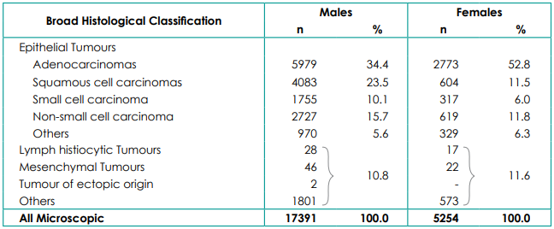
Number and relative proportion of broad histological classification of lung cancer- As per the report of National Cancer Registry Programme (ICMR-NCDIR), Bengaluru, India 2020.¹
Males
Females
Broad Histological Classification
n
%
n
%
34.4 % and 52.8% of cancer lung patients were histologically classified as adenocarcinomas among males and females, respectively. 23.5% males and 11.5% females had squamous cell carcinomas of lung cancer.
1. ICMR. Report of National Cancer REgistry Programme 2020. https://www.ncdirindia.org/All_Reports/Report_2020/default.aspx, accessed on 9th Oct 2023

Slide 15
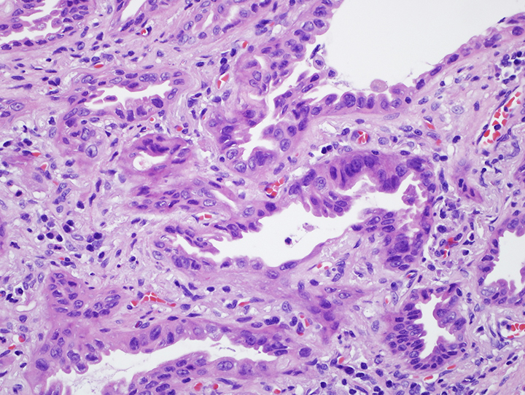
Types of lung cancer
Adenocarcinoma^{1,2,3}
Adenocarcinoma is the most common type of lung cancer, accounting for approximately half of all lung cancer cases in contemporary series
It is frequently seen in non-smokers and former smokers, and it's more common in women compared to other lung cancer subtypes
Patients with advanced lung adenocarcinoma and other non-small carcinomas should undergo testing for driver mutations, including EGFR and ALK alterations
Dubin S, Griffin D. Lung Cancer in Non-Smokers. Mo Med. 2020 Jul-Aug;117(4):375-379. PMID: 32848276; PMCID: PMC7431055. 2. UpToDate.Pathology of lung malignancies. https://www.uptodate.com/contents/pathology-of-lung-malignancies. Access Date: Nov 2, 2023 3. Kawase A, Yoshida J, Ishii G et. al. "Differences Between Squamous Cell Carcinoma and Adenocarcinoma of the Lung: Are Adenocarcinoma and Squamous Cell Carcinoma Prognostically Equal?" Japanese Journal of Clinical Oncology, vol. 42, no. 3, March 2012, pp. 189-195.

Slide 16
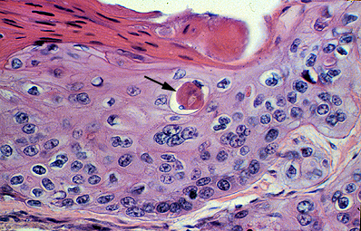
Types of lung cancer
Squamous cell carcinoma¹
Squamous cell carcinoma is strongly associated with history of cigarette smoking
Most squamous cell carcinomas (60 to 80%) arise in the proximal portions of the tracheobronchial tree through a squamous metaplasia-dysplasia-carcinoma in situ sequence
UpToDate.Pathology of lung malignancies.https://www.uptodate.com/contents/pathology-of-lung-malignancies. Access Date: Nov 2, 2023

Slide 17
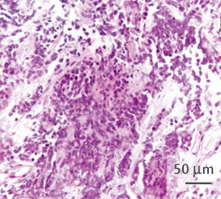
Types of lung cancer
Small cell carcinoma (SCC)¹
Round / oval blue cells with minimal cytoplasm; usually small to medium sized; Nuclear features: finely dispersed chromatin, no distinct nucleoli, molding, smudging, high mitotic rate
High association with smoking
Significant difference in treatment compared to other types
Rudin, C.M., Brambilla, E., Faivre-Finn, C. et al. Small-cell lung cancer. Nat Rev Dis Primers 7, 3 (2021). https://doi.org/10.1038/s41572-020-00235-0

Slide 18

References
GLOBOCAN 2020: New Global Cancer Data. https://www.uicc.org/news/globocan-2020-new-global-cancer-data#:~:text=GLOBOCAN%202020%20is%20an%20online,for%20all%20cancer%20sites%20
combined. Access Date: Nov 1, 2023
All cancers.Source Globocan 2020. Available from https://gco.iarc.fr/today/data/factsheets/cancers/39-All-cancers-fact-sheet.pdf [Accessed on January 2024]
Bray F. et al. Global cancer statistics 2018. CA Cancer J. Clin. 2018;68:394–424. doi: 10.3322/caac.21492.
Sung H. et al. Global Cancer Statistics 2020. CA Cancer J. Clin. 2021;71:209–249. doi: 10.3322/caac.21660.
Meza R. et al. Lung cancer trends in the United States, 1973-2010. PLoS ONE. 2015;10:e0121323. doi: 10.1371/journal.pone.0121323.
Chen V.W. et al. Stage and clinical factors for lung cancer. Cancer. 2014;120:3781–3792. doi: 10.1002/cncr.29045.
Thun M.J. et al. 50-Year trends in smoking-related mortality in the US. N. Engl. J. Med. 2013;368:351–364. doi: 10.1056/NEJMsa1211127.
Lortet-Tieulent J. et al. Convergence of tobacco-related cancer rates in Europe, 1988–2010. Eur. J. Cancer. 2015;51:1144–1163. doi: 10.1016/j.ejca.2013.10.014.
He, Siyi et al. “Survival of 7,311 lung cancer patients by pathological stage and histological classification: a multicenter hospital-based study in China.” Translational lung cancer research vol. 11,8 (2022): 1591-1605. doi:10.21037/tlcr-22-240
Rodak O, Peris-Díaz MD, Olbromski M, Podhorska-Okołów M, Dzięgiel P. Current Landscape of Non-Small Cell Lung Cancer: Epidemiology, Histological Classification, Targeted Therapies, and Immunotherapy. Cancers (Basel). 2021 Sep 20;13(18):4705. doi: 10.3390/cancers13184705. PMID: 34572931; PMCID: PMC8470525.
Singh N, Agrawal S, Jiwnani S, Khosla D, Malik PS, Mohan A, Penumadu P, Prasad KT. Lung Cancer in India. J Thorac Oncol. 2021 Aug;16(8):1250-1266. doi: 10.1016/j.jtho.2021.02.004. PMID: 34304854. https://www.ncdirindia.org/All_Reports/Report_2020/default.aspx, accessed on 9th Oct 2023.
Noronha V, Pinninti R, Patil VM, Joshi A, Prabhash K. Lung cancer in the Indian subcontinent. South Asian J Cancer. 2016 Jul-Sep;5(3):95-103. doi: 10.4103/2278-330X.187571. PMID: 27606290; PMCID: PMC4991146.
Manjunath SN, Madhavabhi IV, Sarkar MS et. al "Risk Factor Profile of Lung Cancer Patients: A Study from the Himalayan State of Indian Subcontinent." Asian Pacific Journal of Cancer Care 7.2 (2022): 239-246
U.S. Public Health Service, office of the Surgeon General: The health consequences of smoking. National Clearinghouse for Smoking Health. 1972.
O'Keeffe LM, Taylor G, Huxley RR, Mitchell P, Woodward M, Peters SAE. Smoking as a risk factor for lung cancer in women and men: a systematic review and meta-analysis. BMJ Open. 2018 Oct 3;8(10):e021611. doi: 10.1136/bmjopen-2018-021611. PMID: 30287668; PMCID: PMC6194454
Shapiro JA, Jacobs EJ, Thun MJ. Cigar smoking in men and risk of death from tobacco-related cancers. J Natl Cancer Inst. 2000;92(4):333–337.
Singh, T., Kaur, A., Katyal, S.K. et al. Exploring the relationship between air quality index and lung cancer mortality in India: predictive modeling and impact assessment. Sci Rep 13, 20256 (2023). https://doi.org/10.1038/s41598-023-47705-5
Lu L, Xu H. An Update on the Classification of Lung and Pleural Tumors. J Clin Transl Pathol. 2023;3(2):106-113. doi: 10.14218/JCTP.2023.00008.
ICMR. Report of National Cancer REgistry Programme 2020. https://www.ncdirindia.org/All_Reports/Report_2020/default.aspx, accessed on 9th Oct 2023
Dubin S, Griffin D. Lung Cancer in Non-Smokers. Mo Med. 2020 Jul-Aug;117(4):375-379. PMID: 32848276; PMCID: PMC7431055.
UpToDate.Pathology of lung malignancies. https://www.uptodate.com/contents/pathology-of-lung-malignancies. Access Date: Nov 2, 2023
Kawase A, Yoshida J, Ishii G et. al. "Differences Between Squamous Cell Carcinoma and Adenocarcinoma of the Lung: Are Adenocarcinoma and Squamous Cell Carcinoma Prognostically Equal?" Japanese Journal of Clinical Oncology, vol. 42, no. 3, March 2012, pp. 189-195.
Rudin, C.M., Brambilla, E., Faivre-Finn, C. et al. Small-cell lung cancer. Nat Rev Dis Primers 7, 3 (2021). https://doi.org/10.1038/s41572-020-00235-0
For the use only of Registered Medical Practitioners or a Hospital or a Laboratory
GCMA - PP-UNP-IND-0251 5th Jan 2024
Pfizer Products India Pvt Ltd, The Capital, B Wing 1802, 18th Floor, Plot No. C-70, G Block, Bandra Kurla Complex, Bandra (East), Mumbai 400051, India

