Slide 1
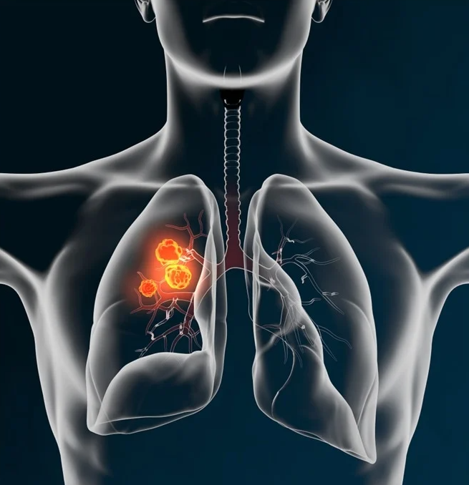

Awareness of
Lung Cancer
GCMA - PP-UNP-IND-0252 5th Jan 2024

Slide 2

Contents
Screening
Signs/Symptoms
Driver mutant lung cancer

Slide 3





Screening of Lung Cancer
Screening programs have become a crucial tool in identifying lung cancer at an early stage, facilitating timely intervention and treatment.¹ Screening with CT scan is the only test that has been proven to reduce mortality from lung cancer in high-risk populations.² NLST showed a 20% reduction in mortality when LDCT was used for screening. LDCT has also been shown to be effective in tuberculosis endemic countries as well as in real-life situations such as ours.²
The NLST showed a lung cancer prevalence of 1% in the screened population with the vast majority (63%) of the lung cancers in stage I and a 20% reduction in mortality in this population.²
It’s always challenging and difficult to develop an effective lung cancer screening program in India in view of a large number of cases of pulmonary tuberculosis and other chest infections.³
But, cost of LDCT, risk of radiation, false positive finding and over-diagnosis make it difficult to implement at mass level.³
NLST: The National Lung Screening Trial; CT: Computed tomography; LDCT: Low dose CT scan
1. Ramaswamy, Anuradha. “Lung Cancer Screening: Review and 2021 Update.” Current pulmonology reports vol. 11,1 (2022): 15-28. doi:10.1007/s13665-021-00283-1.2. Parang S, Bhavin J. LDCT Screening in Smokers in India-A Pilot, Proof-of-Concept Study. Indian J Radiol Imaging. 2021 Apr;31(2):318-322. doi: 10.1055/s-0041-1734227. Epub 2021 Jul 28. PMID: 34556914; PMCID: PMC8448241.3. Shankar A, Saini D, Dubey A, Roy S, Bharati SJ, Singh N, Khanna M, Prasad CP, Singh M, Kumar S, Sirohi B, Seth T, Rinki M, Mohan A, Guleria R, Rath GK. Feasibility of lung cancer screening in developing countries: challenges, opportunities and way forward. Transl Lung Cancer Res 2019;8(Suppl 1):S106-S121. doi: 10.21037/tlcr.2019.03.03

Slide 4





Inclusion and exclusion criteria for screening as recommended by various groups ¹
NLST
USPSTF
Age (years)
Current or former
smoking (pack years)
Quit period for former
smokers (years)
Age (years)
Current or former
smoking (pack years)
Quit period for former
smokers (years)
55–74
50–80
≥ 30
< 15
≥ 20
< 15
X
X
Additional criteria for inclusion
Who should not be screened
(exclusion or discontinuation)
Additional criteria for inclusion
Who should not be screened
(exclusion or discontinuation)
Asymptomatic
History of LC , Chest CT within 18 months, Hemoptysis, Unexplained weight loss of >15 lb in last year
Asymptomatic
Life-limiting health condition, Unable or unwilling to have curative surgery
NLST: National Lung Screening Trial; USPSTF: United States Preventive Services Task Force; LC: Lung cancer; CT: Computed tomography
1. Ramaswamy, Anuradha. “Lung Cancer Screening: Review and 2021 Update.” Current pulmonology reports vol. 11,1 (2022): 15-28. doi:10.1007/s13665-021-00283-1.

Slide 5
Inclusion and exclusion criteria for screening as recommended by various groups ¹
CMS
NCCN
Age (years)
Current or former
smoking (pack years)
Quit period for former
smokers (years)
Age (years)
Current or former
smoking (pack years)
Quit period for former
smokers (years)
55–77
Gp 1: 55–74
Gp 2: ≥50
≥ 30
< 15
Gp 1: ≥ 30, Gp 2: ≥20
< 15
X
Additional criteria for inclusion
Who should not be screened
(exclusion or discontinuation)
Additional criteria for inclusion
Gp 1: Asymptomatic
Gp 2: One of the following: personal history of cancer or certain chronic lung diseases (COPD, pulmonary fibrosis), family history of LC, radon/occupational exposures
Asymptomatic
Life-limiting health condition
Unable or unwilling to have screening/curative treatment
CMS: Centers for Medicare and Medicaid Services; NCCN: National Comprehensive Cancer Network; LC: Lung cancer; COPD: Chronic obstructive pulmonary disease
1. Ramaswamy, Anuradha. “Lung Cancer Screening: Review and 2021 Update.” Current pulmonology reports vol. 11,1 (2022): 15-28. doi:10.1007/s13665-021-00283-1

Slide 6
Inclusion and exclusion criteria for screening as recommended by various groups ¹
ACCP
ATS
IASCLC
ACS
ASCO
ALA
Age (years)
Current or former
smoking (pack years)
Quit period for former
smokers (years)
Additional criteria for inclusion
Age (years)
Current or former
smoking (pack years)
Quit period for former
smokers (years)
55–74
55–80
≥ 30
< 15
Asymptomatic
≥ 30
< 15
AATS
AAFP
LC screening with LDCT not supported currently due to initial concerns about relying on one study alone
Age (years)
Current or former
smoking (pack years)
Quit period for former
smokers (years)
Additional criteria for inclusion
Gp 1: 55–79
Gp 3: 50–79
Gp 1: Asymptomatic, Gp 2: Prior history of LC without recurrence x4 years, starting 5 years post-treatment
Gp 3: Comorbidities which confer ≥5% cumulative risk of LC within 5 years
Gp 1: ≥ 30, Gp 3: ≥ 20
Gp 1: < 15
ACCP: American College of Chest Physicians; ATS: American Thoracic Society; IASCLC: International Association for the Study of Lung Cancer; ACS: American Cancer Society; ASCO: American Society of Clinical Oncology; ALA: American Lung Association; AATS: American Association of Thoracic Surgery; AAFP: American Academy of Family Physicians
1. Ramaswamy, Anuradha. “Lung Cancer Screening: Review and 2021 Update.” Current pulmonology reports vol. 11,1 (2022): 15-28. doi:10.1007/s13665-021-00283-1

Slide 7
Components of a high-quality lung cancer screening program:
combined ACCP and ATS policy statement ¹
01
Who is Offered Lung Cancer Screening?
06
Lung Nodule
Management Algorithms
02
How often, and for
how long, to screen?
07
Smoking Cessation
Programs
Components of
a high quality LC
screening program
03
How the CT Scan is
Performed?
08
Patient and Provider
Education Programs
04
Lung Nodule
Identification
05
Data
Collection
09
Structured
Reporting
ACCP: American College of Chest Physicians; ATS: American Thoracic Society; LC: Lung Cancer; CT scan: Computed Tomography
1. Ramaswamy, Anuradha. “Lung Cancer Screening: Review and 2021 Update.” Current pulmonology reports vol. 11,1 (2022): 15-28. doi:10.1007/s13665-021-00283-1

Slide 8

Components of a high-quality lung cancer screening program:
combined ACCP and ATS policy statement ^{1,2}
01
Who is offered lung cancer screening?
04
Lung nodule identification programs
Those meeting USPSTF criteria
Those who will benefit; without significant comorbidities
Risk data of enrolled patients should be Collected by the program
Have a policy to determine the size and characteristics of positive nodules
Collect nodule data (number, size, characteristics) from positive scans
02
How often, and for how long, to screen?
Annually until 80 years of age if surgical candidate
Stop if patient quits smoking> 15 years ago or develops life-limiting disorder
05
Data collection
Data should be collected on patients enrolled, the other 8 components listed here, and outcomes of testing and details of diagnosed cancers
An annual data review with a plan for quality improvement should occur
Annual reporting of collected data to an oversight agency with credentialing authority should be performed
03
How the CT Scan is performed?
Low dose computed tomography -Technical specifications of ACR- STR should be met
Mean radiation dose data should be collected to ensure compliance with ACR-STR recommendations
ATS: American Thoracic Society; USPSTF: U.S. Preventive Services Task Force; ACCP: American College of Chest Physicians; CT: Computed tomography; ACR-STR American College of Radiology (ACR) and the Society of Thoracic Radiology (STR)
1. Ramaswamy, Anuradha. “Lung Cancer Screening: Review and 2021 Update.” Current pulmonology reports vol. 11,1 (2022): 15-28. doi:10.1007/s13665-021-00283-1. 2. Mazzone, Peter J et al. “Screening for Lung Cancer: CHEST Guideline and Expert Panel Report.” Chest vol. 160,5 (2021): e427-e494. doi:10.1016/j.chest.2021.06.063

Slide 9
Components of a high-quality lung cancer screening program:
combined ACCP and ATS policy statement ^{1,2}
06
Lung nodule management algorithms
08
Patient & provider education programs
Clinicians responsible for management, based on nodule size and characteristics, should be identified
Care pathways for lung nodule management should be developed
Multidisciplinary review such as tumor board conference is recommended
Nodule follow-up should be tracked
Imaging, procedural and surgical resources should be available for further management
Timely communication of results and follow-up plans of nodules and incidental findings should occur
Data should be collected on surveillance, outcomes and further management
Offer education to providers discussing benefits and harms of screening with patients
Develop or use standardized education materials
Be in charge of provider-based patient education
09
Structured reporting
Lung-RADS or an alternative structured reporting system should be used
Compliance data relating to use of such a reporting system should be collected
07
Smoking cessation programs
Have an integrated smoking cessation program
Collect data regarding cessation interventions offered to current smokers
ACCP: American College of Chest Physicians; ATS: ATS American Thoracic Society; Lung-RADS: Lung Imaging Reporting and Data System
1. Ramaswamy, Anuradha. “Lung Cancer Screening: Review and 2021 Update.” Current pulmonology reports vol. 11,1 (2022): 15-28. doi:10.1007/s13665-021-00283-1. 2. Mazzone, Peter J et al. “Screening for Lung Cancer: CHEST Guideline and Expert Panel Report.” Chest vol. 160,5 (2021): e427-e494. doi:10.1016/j.chest.2021.06.063

Slide 10







Pitfalls of screening¹
False Negatives or “Missed”
Diagnoses
Psychosocial Impact
Patients can develop anxiety, depression, and psychological distress over screening results, diagnosis of cancer, or related to complications.
These occur due to observer error, characteristics of the lesion or technical error, and can have medicolegal consequences.
Over diagnosis
Radiation Exposure
This can lead to unnecessary procedures, and contribute to morbidity, anxiety, and expense.
Radiation exposure: CXR - 0.1mSV, LDCT- 1.5 mSV, full-dose CT scan-
8 mSV, PET-CT- 14 mSV. There is a cancer risk from Exposure to ionizing radiation during scanning, which is cumulative throughout life .
False Positives
Increasing the threshold for nodule detection can decrease false positives at the risk of decreasing sensitivity.
Invasive Procedures and Complications
The invasive procedure rates are reported to be approximately 5.1% and 2.7% after screening with LDCT and CXR, respectively, with complication rates also higher in patients who were screen-positive by LDCT compared to CXR.
CXR: chest X-ray ; CT: Computed tomography; PET-CT: Positron Emission Tomography and Computed Tomography; LDCT: Low dose CT scan; CXR: chest X-ray
1. Ramaswamy, Anuradha. “Lung Cancer Screening: Review and 2021 Update.” Current pulmonology reports vol. 11,1 (2022): 15-28. doi:10.1007/s13665-021-00283-1

Slide 11








Biomarkers in screening¹
Auto antibodies
Complement fragments
Circulating DNA & microRNA
signature profiles
Circulating proteins
Following
biomarkers are
being studied
Image analysis of sputum
Exhaled breath
condensates
Artificial intelligence based sputum cytology
Airway gene expression
Metabolomics
Currently being utilized in patients with lung nodules to assist with lung cancer risk stratification
DNA: Deoxyribonucleic acidDNA Deoxyribonucleic acid; RNA: Ribonucleic acid
1. Ramaswamy, Anuradha. “Lung Cancer Screening: Review and 2021 Update.” Current pulmonology reports vol. 11,1 (2022): 15-28. doi:10.1007/s13665-021-00283-1.

Slide 12




Summary of Screening Recommendations ¹
In patients at risk for developing lung cancer, screening for lung cancer with chest radiograph (CXR) once or at regular intervals is not recommended (Grade 1 A)
In patients at risk for developing lung cancer, screening for lung cancer with sputum cytology at regular intervals is not suggested (Grade 2A)
For smokers and former smokers who are age 55 to 74 and who have smoked for 30 pack-years or more and either continue to smoke or have quit within the past 15 years, we suggest that annual screening with low-dose CT (LDCT) should be offered over both annual screening with CXR or no screening, but only in settings that can deliver the comprehensive care provided to National Lung Screening Trial participants (Grade 2B)
For individuals who have accumulated fewer than 30 pack-years of smoking or are either younger than age 55 or older than 74, or individuals who quit smoking more than 15 years ago, and for individuals with severe comorbidities that would preclude potentially curative treatment and/or limit life expectancy, we suggest that CT screening should not be performed (Grade 2C)
* The information provided is not based on Indian guidelines.
CXR: Chest X-ray; CT: Computed tomography; LDCT: Low dose CT scan;
1. Detterbeck FC, Mazzone PJ, Naidich DP, Bach PB. Screening for lung cancer: Diagnosis and management of lung cancer, 3rd ed: American College of Chest Physicians evidence-based clinical practice guidelines. Chest. 2013 May;143(5 Suppl):e78S-e92S. doi: 10.1378/chest.12-2350. PMID: 23649455; PMCID: PMC3749713.

Slide 13

Summary of Screening Recommendations ¹
`
Screening for lung cancer involves a complex interplay of patient selection, counselling, risk modification, an organized process for screening and scan interpretation, and judgment to minimize further testing to only those instances in which it is necessary. ¹
With attention to detail and ongoing refinement of the process, LDCT screening for lung cancer has the potential to have a major impact on the reduction of cancer deaths.¹
* The information provided is not based on Indian guidelines.
LDCT: Low dose CT scan;
1. Detterbeck FC, Mazzone PJ, Naidich DP, Bach PB. Screening for lung cancer: Diagnosis and management of lung cancer, 3rd ed: American College of Chest Physicians evidence-based clinical practice guidelines. Chest. 2013 May;143(5 Suppl):e78S-e92S. doi: 10.1378/chest.12-2350. PMID: 23649455; PMCID: PMC3749713.

Slide 14
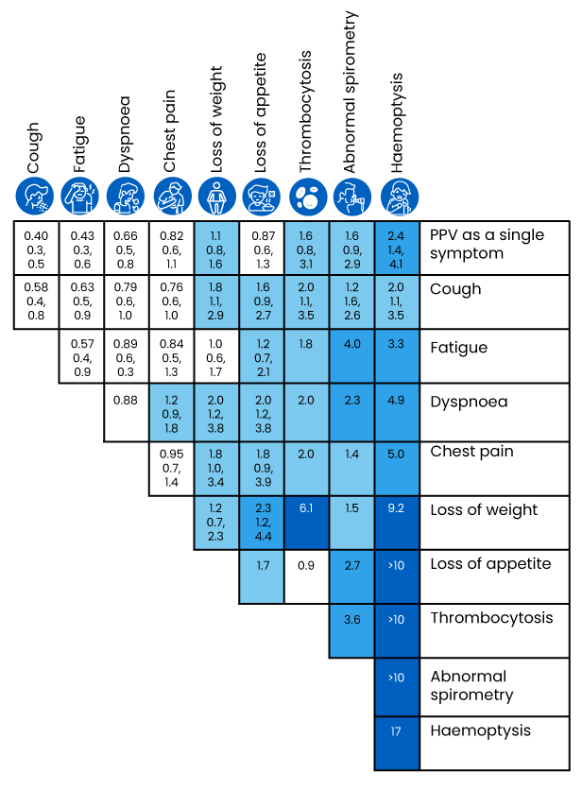
Signs / Symptoms of Lung Cancer
The earliest stage of lung cancer is often not associated with any symptoms.¹
The most common symptoms associated with lung cancer tend to be both common in benign presentations in the community and particularly amongst smokers.¹
Therefore, the discriminative utility of most of these symptoms in isolation is low.¹
Positive predictive values (PPVs) for different symptoms of lung cancer, both alone and in combination, have been determined from a case–control study and is presented below.¹
Positive predictive values (%) for lung cancer for individual risk markers, and for pairs of risk markers in the PPV. These have not been calculated when any cell in the 2 × 2 table was below 10. combination (against a background risk of 0.18%). (1) The top row (bold) gives the PPV for an individual feature. The cells along the diagonal relate to the PPV when the same feature has been reported twice. Other cells show the PPV when a patient has two different features. (2) The top figure in each cell is the PPV. It has only been calculated when a minimum of ten cases had the feature or combination of features. The two other figures are the 95% CIs for (3) The light blue shading is when the PPV is above 1%. The mid blue shading is when the PPV is above 2%. The dark blue shading is for PPVs above 5.0%
PPVs: Positive predictive values
1. Bradley SH, Kennedy MPT, Neal RD. Recognising Lung Cancer in Primary Care. Adv Ther. 2019 Jan;36(1):19-30. doi: 10.1007/s12325-018-0843-5. Epub 2018 Nov 29. Erratum in: Adv Ther. 2020 Apr;37(4):1701. PMID: 30499068; PMCID: PMC6318240.

Slide 15




Clinical Manifestations of Lung cancer
Occurs in Lung cancers arising in the superior sulcus. Manifested by pain (usually in the shoulder, and less commonly in the arm, scapula, and fingers), Horner syndrome, bony destruction, and atrophy of hand muscles
Present in 50 to 75 percent of lung cancer patients
Pancoast
syndrome
Intrathoracic clinical manifestations¹
Cough
Chest pain
Present in approximately 20 to 40 percent of patients
Reported by 15 to 30
percent of patients
Hemoptysis
1. UpToDate. Clinical manifestations of Lung Cancer. https://www.uptodate.com/contents/clinical-manifestations-of-lung-cancer. Access Date: Nov 6, 2023

Slide 16




Clinical Manifestations of Lung cancer
During the course of disease, approximately 10 to 15 percent of lung cancer patients have a malignant pleural effusion¹
More common in patients with SCLC than NSCLC^{1,2}
Pleural involvement
(Can occur in both right and left side due to lymph node involvement)
Intrathoracic clinical manifestations¹
Dyspnea (shortness of breath)
Superior vena cava syndrome
Present in approximately 25 to 40 percent of patients¹
Hoarseness
SCLC: Small cell lung cancer; NSCLC: NSCLC Non-Small Cell Lung Cancer
1. American Cancer Society. Signs and Symptoms of Lung Cancer. Lung Cancer Signs & Symptoms | Common Symptoms of Lung Cancer Access Date: Jan 30, 2024
2. Cohen R, Mena D, Carbajal-Mendoza R, Matos N, Karki N. Superior vena cava syndrome: A medical emergency? Int J Angiol. 2008 Spring;17(1):43-6. doi: 10.1055/s-0031-1278280. PMID: 22477372; PMCID: PMC2728369.

Slide 17
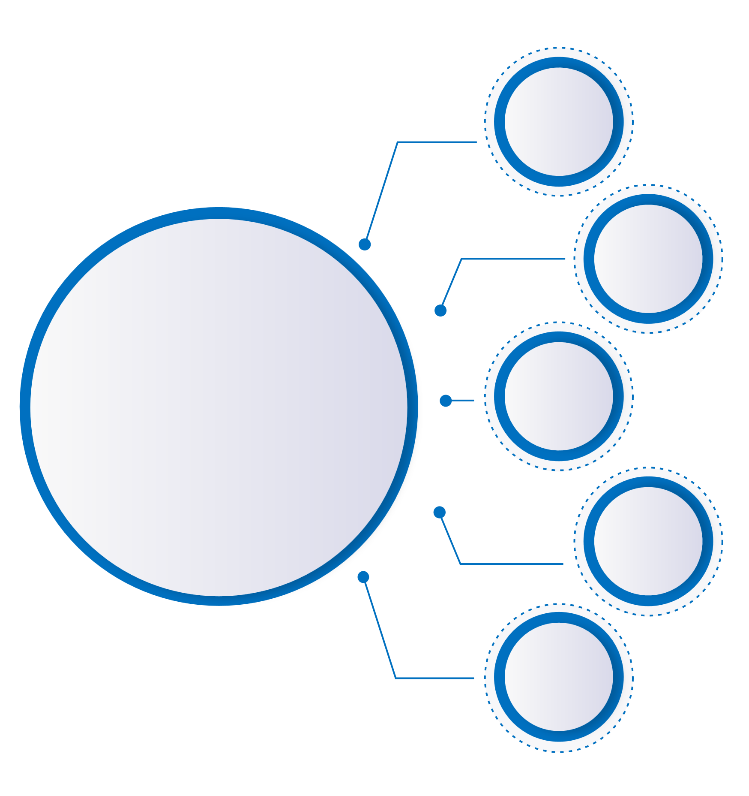





Clinical Manifestations of Lung cancer
Bone: Metastasis from lungs to bone includes pain in the back, chest, or extremity and elevated levels of serum alkaline phosphatase.
Constitutional Symptoms: Includes weight loss, anorexia, weakness, and fatigue.
Clinical manifestations
of extrathoracic
metastases¹
Adrenal: Adrenal metastasis may have localized symptoms (eg: back or abdominal pain) if the tumor is large or rapidly growing or has caused a retroperitoneal hemorrhage.
Liver: Hepatic metastasis is uncommon, and are detected by liver enzyme abnormalities, CT, PET.
Brain: Neurologic manifestations of lung cancer include metastases and paraneoplastic syndromes. Symptoms from central nervous system metastasis are similar to those with other tumors and include headache, vomiting, visual field loss, hemiparesis, cranial nerve deficit, and seizures.
CT: Computed tomography; PET: Positron emission tomography
1. UpToDate. Clinical manifestations of Lung Cancer. https://www.uptodate.com/contents/clinical-manifestations-of-lung-cancer. Access Date: Nov 6, 2023

Slide 18



Clinical Manifestations of Lung cancer
Paraneoplastic phenomena¹
SIADH secretion - The syndrome of inappropriate antidiuretic hormone secretion (SIADH) is frequently caused by SCLC and results in hyponatremia. Approximately 10 percent of patients who have SCLC exhibit SIADH. SCLC accounts for approximately 75 percent of all malignancy-related occurrences of SIADH.
Hypercalcemia - (Symptoms of hypercalcemia include anorexia, nausea, vomiting, constipation, lethargy, polyuria, polydipsia, and dehydration. Confusion and coma are late manifestations as are renal failure and nephrocalcinosis).
Neurologic syndromes - Includes Lambert-Eaton myasthenic syndrome (LEMS), cerebellar ataxia, sensory neuropathy, limbic encephalitis, encephalomyelitis, autonomic neuropathy, retinopathy, and opsomyoclonus.
LEMS: Lambert-Eaton myasthenic syndrome; SCLC: Small cell lung cancer; SIADH: syndrome of inappropriate antidiuretic hormone secretion
1. UpToDate. Clinical manifestations of Lung Cancer. https://www.uptodate.com/contents/clinical-manifestations-of-lung-cancer. Access Date: Nov 6, 2023

Slide 19




Clinical Manifestations of Lung cancer
Hematologic manifestations¹
Hypertrophic osteoarthropathy¹
Characterized by a symmetrical, painful arthropathy and long-bone pain that usually involves the ankles, knees, wrists, and elbows. The metacarpal, metatarsal, and phalangeal bones may also be involved.
Anemia
Leukocytosis
Thrombocytosis
Eosinophilia
Hypercoagulable disorders:
  Superficial thrombophlebitis
  (Trousseau syndrome)
  Deep venous thrombosis and thromboembolism
  Disseminated intravascular coagulopathy
  Thrombotic microangiopathy
  Nonbacterial thrombotic endocarditis
Dermatomyositis and polymyositis¹
These are two distinct forms of inflammatory myopathy, both of which are manifested clinically by muscle weakness.
Cushing syndrome¹
Patients typically present with muscle weakness, weight gain, hypertension, hirsutism, and osteoporosis. Cushing syndrome is rare, but is most commonly seen in patients with SCLC, large cell neuroendocrine carcinoma, or carcinoid tumors of the lung.
SCLC: Small cell lung cancer;
1. UpToDate. Clinical manifestations of Lung Cancer. https://www.uptodate.com/contents/clinical-manifestations-of-lung-cancer. Access Date: Nov 6, 2023

Slide 20





Driver mutant Lung Cancer
Oncogenic driver mutations initiate and sustain cancer by affecting genes that encode vital signalling proteins for cellular growth and survival.¹
Many trials are ongoing, some of them through serial tumor or plasma biopsies and multiplex molecular testing.²
A significant proportion of lung cancer patients present alterations in certain genes that drive oncogenesis.²
EGFR exon 19 mutations are common followed by the ALK fusion and ROS 1 fusion^{3,4}
Currently, more than fifteen targeted agents are FDA-approved for seven oncogenic drivers in non-small-cell lung cancer, highlighting the importance of actively searching for these mutations.²
EGFR: Epidermal growth factor receptor; ALK: Anaplastic lymphoma kinase; ROS1: c-ROS oncogene 1
1. Luo SY, Lam DC. Oncogenic driver mutations in lung cancer. Transl Respir Med. 2013 Dec;1(1):6. doi: 10.1186/2213-0802-1-6. Epub 2013 Mar 8. PMID: 27234388; PMCID: PMC6733434. 2. Chevallier M, Borgeaud M, Addeo A, Friedlaender A. Oncogenic driver mutations in non-small cell lung cancer: Past, present and future. World J Clin Oncol 2021; 12(4): 217-237 3. Noronha V, Pinninti R, Patil VM, Joshi A, Prabhash K. Lung cancer in the Indian subcontinent. South Asian J Cancer. 2016 Jul-Sep;5(3):95-103. doi: 10.4103/2278-330X.187571. PMID: 27606290; PMCID: PMC4991146. 4. Tarigopula, Anil et al. “EGFR mutations and ROS1 and ALK rearrangements in a large series of non-small cell lung cancer in South India.” Cancer reports (Hoboken, N.J.) vol. 3,6 (2020): e1288. doi:10.1002/cnr2.1288

Slide 21
Incidence of oncogenic drivers in non-small cell lung cancer¹
ALK
RET
3%
1%
1%
ROS1
MET
3%
0%
NTRK
HER2
3%
5%
BRAF
29%
KRAS
9%
Other Genes
Unknown
27%
ORR: Objective response rate; PFS: Progression-free survival; OS: Overall survival; EGFR: Epidermal growth factor receptor; ALK: Anaplastic lymphoma kinase; ROS1: c-ROS oncogene 1; NTRK: Neurotrophic receptor tyrosine kinase; RET: Rearranged during transfection; KRAS: Kirsten rat sarcoma; HER2: Human epidermal growth factor 2; NRG1: Neuregulin-1; BRAF: V-raf murine sarcoma viral oncogene homolog B. NA: Not available.
1. Chevallier M, Borgeaud M, Addeo A, Friedlaender A. Oncogenic driver mutations in non-small cell lung cancer: Past, present and future. World J Clin Oncol 2021; 12(4): 217-237

Slide 22
A suggested schema for guidance of clinical testing for oncogenic driver mutations which aid in personalized treatment in lung cancer. ¹
Lung Cancer
Small Cell
Lung Cancer
(SCLC)
Non-Small-Cell
Lung Cancer
(N SCLC)
Histology based
Adenocarcinoma
(AD)
Squamous Cell
Carcinoma (SCC)
Large Cell
Carcinoma (LCC)
Mutation
Profiling by NGS
Therapeutic
decision & Clinical Outcome
EGFR Mutation
Primary Resistance
To TKI
Other molecular
driving mutations :
KRAS, EML4-ALK, MET, etc
TKI Responsive
KRAS: Kirsten rat sarcoma; EGFR: Epidermal growth factor receptor; TKI: Tyrosine kinase inhibitors; ALK: Anaplastic lymphoma kinase; NGS Next generation sequencing; EML4-ALK: echinoderm microtubule-associated protein-like 4-anaplastic lymphoma kinase; MET: Mesenchymal epithelial transition factor receptor
1.Luo SY, Lam DC. Oncogenic driver mutations in lung cancer. Transl Respir Med. 2013 Dec;1(1):6. doi: 10.1186/2213-0802-1-6. Epub 2013 Mar 8. PMID: 27234388; PMCID: PMC6733434.

Slide 23
Selected oncogenic drivers and their treatments in non-small cell lung cancer¹⁻⁴
Targeted therapy
ORR
PFS
OS
EGFR
Erlotinib
Gefitinib
Afatinib
Dacomitinib
Osimertinib
62% - 83%
73.70%
56% - 67%
74.90%
80%
9.7 -13.1 mo
9.5 mo
11.1 mo
14.7 mo
18.9 mo
19.3 – 26.3 mo
22 mo
25.8 mo
34 mo
38.6 mo
ORR: Objective response rate; PFS: Progression-free survival; OS: Overall survival; EGFR: Epidermal growth factor receptor; mo: Months
1. Chevallier M, Borgeaud M, Addeo A, Friedlaender A. Oncogenic driver mutations in non-small cell lung cancer: Past, present and future. World J Clin Oncol 2021; 12(4): 217-237

Slide 24
Selected oncogenic drivers and their treatments in non-small cell lung cancer¹
Targeted therapy
ORR
PFS
OS
ALK
Crizotinib
Ceritinib
Brigatinib
Alectinib
Lorlatinib
75.50%
72.50%
79%
82.90%
76%
11 mo
16.6 mo
24 mo
35 mo
NA
57 mo
NA
NA
NA
NA
Targeted therapy
ORR
PFS
OS
ROS1
Crizotinib
Lorlatinib
Entrectinib
63-72%
62%
77%
15.9 – 19.2 mo
19.3 mo
19 mo
51 mo
NA
NA
ORR: Objective response rate; PFS: Progression-free survival; OS: Overall survival; ALK: Anaplastic lymphoma kinase; ROS1: c-ROS oncogene 1; mo : Months; NA: Not available;
1. Chevallier M, et al. Oncogenic driver mutations in NSCLC: Past, present, future. World J Clin Oncol 2021; 12(4): 217-237.

Slide 25
Selected oncogenic drivers and their treatments in non-small cell lung cancer¹
Targeted therapy
ORR
PFS
OS
MET
Crizotinib
Cabozatinib
Capmatinib
Tepotinib
32%
NA
68%
46%
7.3 mo
NA
9.7 mo
NA
NA
NA
NA
NA
Targeted therapy
ORR
PFS
OS
BRAF
Dabrafenib-
trametinib
64%
10.9 mo
24.6 mo
Targeted therapy
ORR
PFS
OS
HER2
Trastuzumab-
deruxtecan
62%
14 mo
NA
ORR: Objective response rate; PFS: Progression-free survival; OS: Overall survival; HER2: Human epidermal growth factor 2; BRAF: V-raf murine sarcoma viral oncogene homolog B. ; MET: Mesenchymal epithelial transition factor receptor; mo : Months; NA: Not available
1. Chevallier M, Borgeaud M, Addeo A, Friedlaender A. Oncogenic driver mutations in non-small cell lung cancer: Past, present and future. World J Clin Oncol 2021; 12(4): 217-237

Slide 26
Selected oncogenic drivers and their treatments in non-small cell lung cancer¹
Targeted therapy
ORR
PFS
OS
NTRK
Entrectinib
Larotrectinib
70%
75%
NA
NA
NA
NA
Targeted therapy
ORR
PFS
OS
RET
Selpercatinib
Pralsetinib
85%
70%
NA
NA
NA
NA
Targeted therapy
ORR
PFS
OS
KRAS
Sotorasib
Adagrasib
32.20%
45%
10.2 mo
NA
NA
NA
ORR: Objective response rate; PFS: Progression-free survival; OS: Overall survival; NTRK: Neurotrophic receptor tyrosine kinase; RET: Rearranged during transfection; KRAS: Kirsten rat sarcoma; NA: Not available.; mo:Months
1. Chevallier M, Borgeaud M, Addeo A, Friedlaender A. Oncogenic driver mutations in non-small cell lung cancer: Past, present and future. World J Clin Oncol 2021; 12(4): 217-237

Slide 27




Since 2018, ASCO has recommended routine mutation testing for driver genes including EGFR, ALK, ROS1 and BRAF in clinical practice for patients with metastatic NSCLC.¹
NGS has the potential and benefit of providing all the relevant biomarkers in a single test thus saving valuable time and biopsy tissue²
Barring a therapeutic emergency, no patient should be started on systemic therapy before a comprehensive molecular analysis has been completed.¹
In the 20th century, every gene matters, and it would be unethical to deny patients access to proven targeted therapies given the efficacy and favourable toxicity profile of such drugs.¹
Understanding into the biological mechanisms underlying these oncogenic driver mutations, the clinical relevance of these driver mutations will allow for further advancement into targeted therapeutics in lung cancer.²
ASCO: American Society of Clinical Oncology; EGFR: epidermal growth factor receptor; ALK: anaplastic lymphoma kinase; ROS1: receptor tyrosine kinase; BRAF: B-raf proto-oncogene; NSCLC: Non-Small Cell Lung Cancer; NGS: Next generation sequencing
1.Chevallier M, Borgeaud M, Addeo A, Friedlaender A. Oncogenic driver mutations in non-small cell lung cancer: Past, present and future. World J Clin Oncol 2021; 12(4): 217-237 2. Ewalt MD, West H, Aisner DL. Next Generation Sequencing—Testing Multiple Genetic Markers at Once. JAMA Oncol. 2019;5(7):1076. doi:10.1001/jamaoncol.2019.0453

Slide 28
References :
Ramaswamy, Anuradha. “Lung Cancer Screening: Review and 2021 Update.” Current pulmonology reports vol. 11,1 (2022): 15-28. doi:10.1007/s13665-021-00283-1
Parang S, Bhavin J. LDCT Screening in Smokers in India-A Pilot, Proof-of-Concept Study. Indian J Radiol Imaging. 2021 Apr;31(2):318-322. doi: 10.1055/s-0041-1734227. Epub 2021 Jul 28. PMID: 34556914; PMCID: PMC8448241.
Shankar A, Saini D, Dubey A, Roy S, Bharati SJ, Singh N, Khanna M, Prasad CP, Singh M, Kumar S, Sirohi B, Seth T, Rinki M, Mohan A, Guleria R, Rath GK. Feasibility of lung cancer screening in developing countries: challenges, opportunities and way forward. Transl Lung Cancer Res 2019;8(Suppl 1):S106-S121. doi: 10.21037/tlcr.2019.03.03
Mazzone, Peter J et al. “Screening for Lung Cancer: CHEST Guideline and Expert Panel Report.” Chest vol. 160,5 (2021): e427-e494. doi:10.1016/j.chest.2021.06.063
Detterbeck FC, Mazzone PJ, Naidich DP, Bach PB. Screening for lung cancer: Diagnosis and management of lung cancer, 3rd ed: American College of Chest Physicians evidence-based clinical practice guidelines. Chest. 2013 May;143(5 Suppl):e78S-e92S. doi: 10.1378/chest.12-2350. PMID: 23649455; PMCID: PMC3749713.
Bradley SH, Kennedy MPT, Neal RD. Recognising Lung Cancer in Primary Care. Adv Ther. 2019 Jan;36(1):19-30. doi: 10.1007/s12325-018-0843-5. Epub 2018 Nov 29. Erratum in: Adv Ther. 2020 Apr;37(4):1701. PMID: 30499068; PMCID: PMC6318240.
UpToDate. Clinical manifestations of Lung Cancer. https://www.uptodate.com/contents/clinical-manifestations-of-lung-cancer. Access Date: Nov 6, 2023
Cohen R, Mena D, Carbajal-Mendoza R, Matos N, Karki N. Superior vena cava syndrome: A medical emergency? Int J Angiol. 2008 Spring;17(1):43-6. doi: 10.1055/s-0031-1278280. PMID: 22477372; PMCID: PMC2728369.
Luo SY, Lam DC. Oncogenic driver mutations in lung cancer. Transl Respir Med. 2013 Dec;1(1):6. doi: 10.1186/2213-0802-1-6. Epub 2013 Mar 8. PMID: 27234388; PMCID: PMC6733434.
Chevallier M, Borgeaud M, Addeo A, Friedlaender A. Oncogenic driver mutations in non-small cell lung cancer: Past, present and future. World J Clin Oncol 2021; 12(4): 217-237
Noronha V, Pinninti R, Patil VM, Joshi A, Prabhash K. Lung cancer in the Indian subcontinent. South Asian J Cancer. 2016 Jul-Sep;5(3):95-103. doi: 10.4103/2278-330X.187571. PMID: 27606290; PMCID: PMC4991146.
Tarigopula, Anil et al. “EGFR mutations and ROS1 and ALK rearrangements in a large series of non-small cell lung cancer in South India.” Cancer reports (Hoboken, N.J.) vol. 3,6 (2020): e1288. doi:10.1002/cnr2.1288
Ewalt MD, West H, Aisner DL. Next Generation Sequencing—Testing Multiple Genetic Markers at Once. JAMA Oncol. 2019;5(7):1076. doi:10.1001/jamaoncol.2019.0453
For the use only of Registered Medical Practitioners or a Hospital or a Laboratory
GCMA - PP-UNP-IND-0252 5th Jan 2024
Pfizer Products India Pvt Ltd, The Capital, B Wing 1802, 18th Floor, Plot No. C-70, G Block, Bandra Kurla Complex, Bandra (East), Mumbai 400051, India

