Slide 1
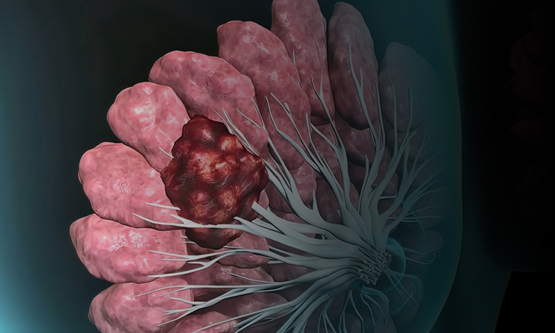

Management of Advanced Breast Cancer
- Breast Cancer Awareness
See the summary of prescribing information on last slide
PP-UNP-IND-0214 02-11-2023

Slide 2




Early stages of breast cancer
The term 'early breast cancer' refers to stages of breast cancer labeled 0, I, II, and IIIA
Stage 0
Stage II
Abnormal of cancer cells are present in either the lining of a breast lobule or a duct, but they have not spread to the surrounding fatty tissue. This stage is also called lobular carcinoma in situ(LCIS), or ductal carcinoma in situ (DCIS).
In this stage, the tumor can range from about 2 cm to less than 5 cm in diameter (approximately 1 to 2 inches; sometimes lymph nodes may not be involved.
Stage I
Stage IIIA
Cancer has spread from the lobules or ducts to nearby tissue in the breast. At this stage and beyond, breast cancer is considered to be invasive. The tumor is 2 cm or less in diameter (approximately 1 inch or less); cancer has not spread to the lymph nodes.
In this stage, the tumor is 5 cm or greater in diameter (approximately 2 inches or greater); or the tumor may be of any size where cancer cells have grown extensively into axillary (underarm) lymph nodes.
Breast Cancer Stages. Available at: https://www.breastcancer.org/pathology-report/breast-cancer-stages

Slide 3
Advanced stages of breast cancer
Ther term 'advanced breast cancer' refers to stages of breast cancer labeled IIIB, IIIC and IV
Stages IIIB/IIIC
Stage IV
Known as locally advanced cancer; tumor may be of any size but has spread into the skin of the breast, tissues of the chest wall, or lymph nodes near the collarbone.
Known as metastatic; cancer has spread from the breast to other parts of the body, such as bone, liver, lung, or brain.
Stage 0
Stage I
Stage II
Stage III
Stage IV
Carcinoma in situ - Early form
Localized
Early Locally Advanced
Late Locally Advanced
Metastasized
Breast Cancer Stages. Available at: https://www.breastcancer.org/pathology-report/breast-cancer-stages

Slide 4
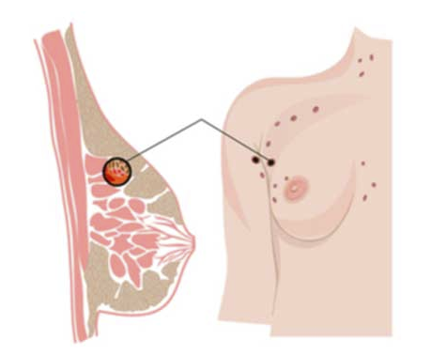
Metastatic breast cancer
Patients with metastatic breast cancer (MBC) have a 5-year overall survival of only 27%
Need for novel therapeutic options to improve survival for patients with MBC
Numerous ongoing clinical trials are evaluating immuno-oncology (IO) agents in combination with chemotherapy, radiotherapy, other immune checkpoint inhibitors or cancer vaccines
Rapid increase in the development of diverse IO agents targeting numerous pathways extending beyond CTLA-4 and PD-1/PD-L1
Schreiber AR, Kagihara JA, Weiss JA, et al. Clinical Outcomes for Patients With Metastatic Breast Cancer Treated With Immunotherapy Agents in Phase I Clinical Trials. Frontiers in oncology. 2021 Mar 17;11:800.

Slide 5
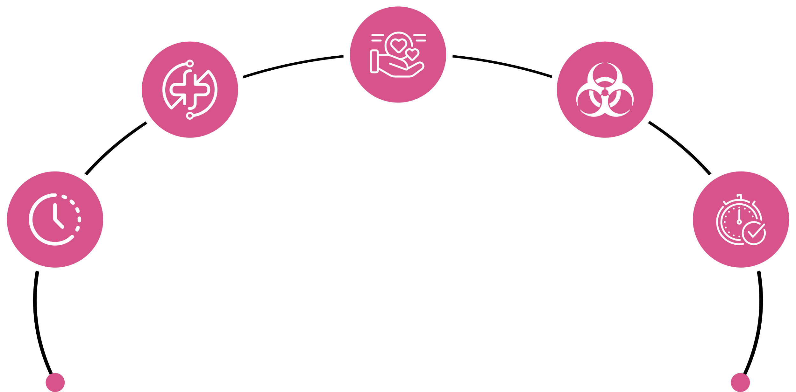
Management of metastatic breast cancer
Symptom relief & quality of life
Prolongation of survival
Restricting treatment-related toxicity
Improvements in
time to progression
Improvements
in duration of
response
Goals of
Treatment
Chung CT, Carlson RW. Goals and objectives in the management of metastatic breast cancer. The oncologist. 2003 Dec;8(6):514-20. Smith I. Goals of treatment for patients with metastatic breast cancer. InSeminars in oncology 2006 Feb 1 (Vol. 33, pp. 2-5). WB Saunders.

Slide 6

Treatment algorithm for newly diagnosed MBC patients
Stage IV (M1) or Recurrent
History and physical exam
Discuss goals of therapy, adopt shared decision-making, and document course of care
CBC
Comprehensive metabolic panel, including liver function tests and alkaline phosphatase
Imaging for systematic staging:
Chest diagnostic CT with contrast
Abdominal ± pelvic diagnostic CT with contrast or MRI with contrast
Brain MRI with contrast if suspicious CNS symptoms
Spine MRI with contrast if back pain or symptoms of cord compression
Bone scan or sodium fluoride PET/CT^{ss} (category 2B)
FDG PET/CT^{tt} (optional)
X-rays of symptomatic bones and long weight-bearing bones abnormal on bone scan
Biomarker testing:
Biopsy of first recurrence of disease
Evaluation of ER/PR and HER2 status to differentiate recurrent disease from new primary^{d,ccc,ddd}
Comprehensive germline and somatic profiling to identify candidates for additional targeted therapies
Genetic counseling if patient is at risk^{e} for hereditary breast cancer
Assess for distress^{g}
NCCN 2021. Available at: https://www.nccn.org/professionals/physician_gls/pdf/breast.pdf

Slide 7
Treatment algorithm for newly diagnosed MBC patients
Local only recurrence
Initial treatment with mastectomy + level I/II axillary dissection and prior RT
Initial treatment with mastectomy and no prior RT
Initial treatment with lumpectomy + RT
Total mastectomy + axillary lymph node staging if level I/II axillary dissection not previously done
surgical resection if possible
surgical resection if possible +RT
NCCN 2021. Available at: https://www.nccn.org/professionals/physician_gls/pdf/breast.pdf

Slide 8
Treatment algorithm for newly diagnosed MBC patients
Regional only or Local and regional recurrence
Supraclavicular recurrence
Internal mammary node recurrence
Axillary recurrence
Surgical resection if possible + RT if possible
RT if possible
RT is possible
NCCN 2021. Available at: https://www.nccn.org/professionals/physician_gls/pdf/breast.pdf

Slide 9


Targeted Therapies
HER2-overexpressing
Trastuzumab Lapatinib
T-DM1 Pertuzumab
MM-111
Triple Negative
Platinum Salts
Anti-EGFR therapies
PARP inhibitors
PTEN loss
Anti-PI3Kβ
New targeted biologic therapies will block essential functions of cancer cells and tumour stroma.¹
PI3K mutant
Anti-PI3K,
Anti-AKT, and
mTOR-targeting
therapies
BRCA21 mutant
BRCA2 mutant
PARP
inhibitors
HR positive
Tamoxifen Als
Fulvestrant
Cabozantinib
MM-121
CDK4/6
inhibitors
Venn diagram of breast cancer subtypes and their overlapping molecular targets²
1. Sánchez-Muñoz A, Pérez-Ruiz E, Jiménez B, et al. Targeted therapy of metastatic breast cancer. Clinical and Translational Oncology. 2009 Oct;11(10):643-50.
2. Higgins MJ, Baselga J. Targeted therapies for breast cancer. The Journal of clinical investigation. 2011 Oct 3;121(10):3797-803.
3. Yin L, Duan JJ, Bian XW, et al. Triple-negative breast cancer molecular subtyping and treatment progress. Breast Cancer Research. 2020 Dec;22(1):1-3.

Slide 10

HR-positive (HR+) metastatic breast cancer
60–80% of breast cancer cases are HR+
Endocrine therapy (ET)
Mainstay for treatment
30% experience relapse.
Current armamentarium of ET includes
Selective estrogen receptor (ER) Selective estrogen receptor modulators (SERMs),
AIs and ER downregulators (SERDs)
Reinert T, Barrios CH. Optimal management of hormone receptor positive metastatic breast cancer in 2016. Therapeutic advances in medical oncology. 2015 Nov;7(6):304-20.

Slide 11



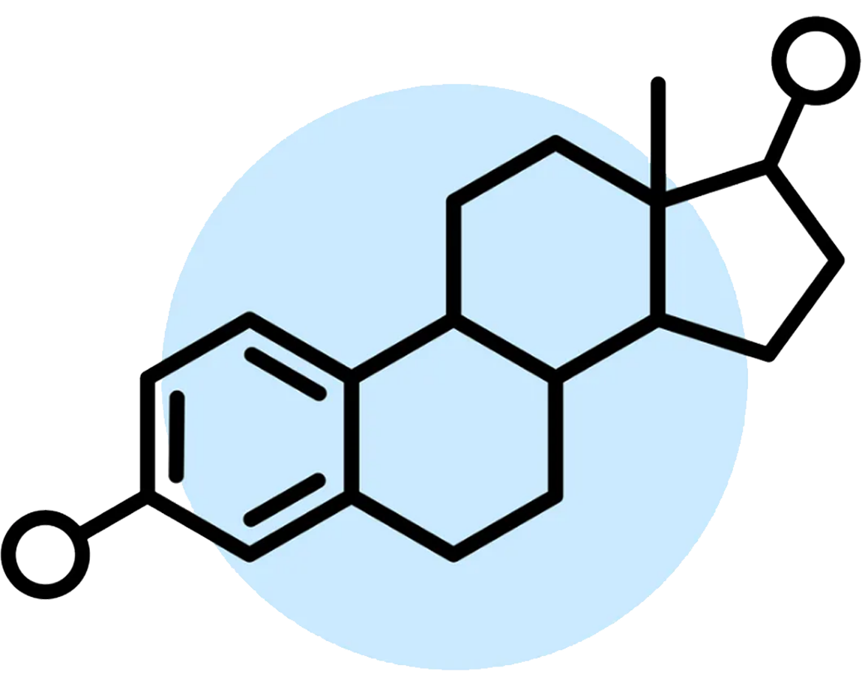

Management of HR+MBC
Ovarian suppression
Aromatase inhibitors
Anti-estrogens
Hormones
Chemotherapy
Stops the ovaries from making hormones temporarily using LHRH agonists
Stop a type of hormone called androgen from changing into estrogen by an enzyme called aromatase
Prevents hormones from binding to receptors. SERMS block estrogen from attaching to hormone receptors. SERDS block and destroy estrogen receptors
When taken in high doses may treat breast cancer. Hormones include ethinyl estradiol, fluoxymesterone & megestrol acetate
Chemotherapy with trastuzumab or pertuzumab
SERMS: Selective estrogen receptor modulators, SERDS: Selective estrogen receptor degraders,
NCCN guidelines. Available at: https://www.nccn.org/patients/guidelines/content/PDF/breast-invasive-patient.pdf

Slide 12
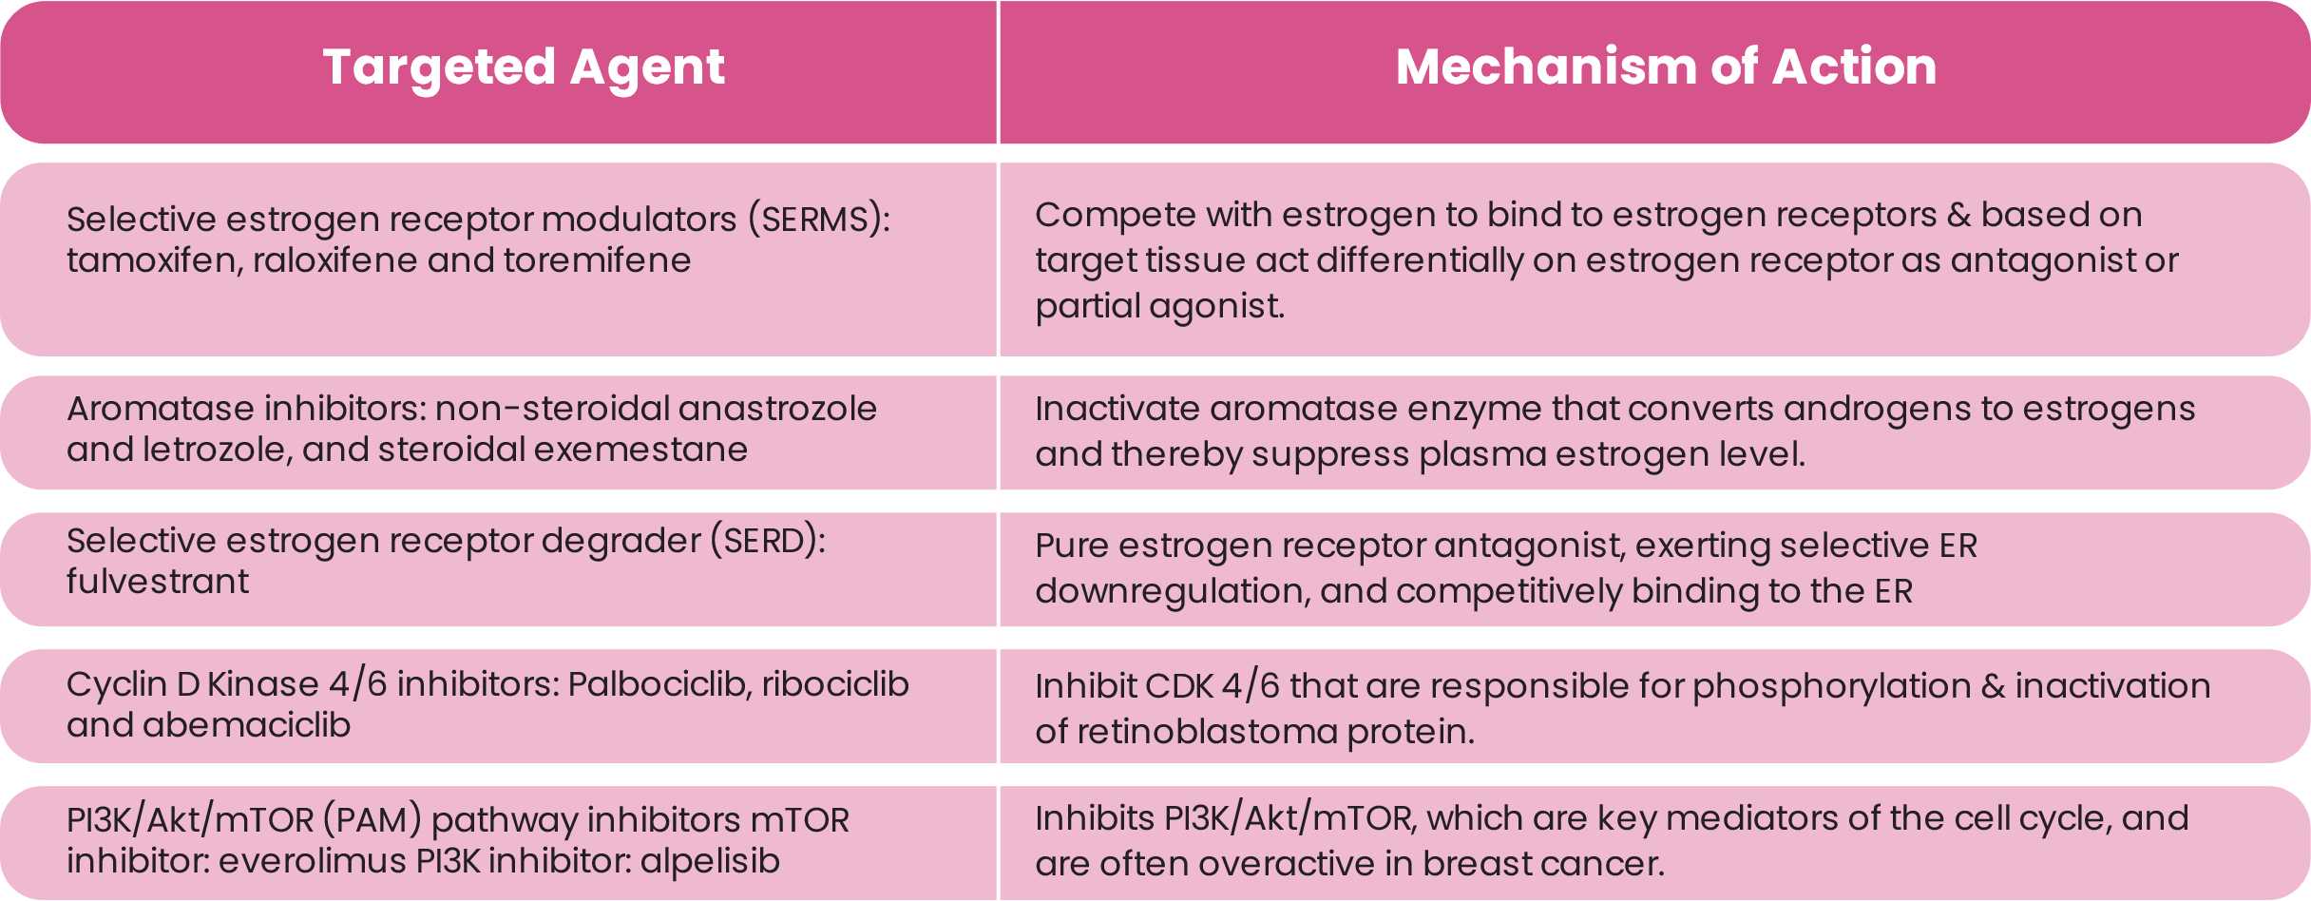
Endocrine Therapy
Key targeted therapies that are approved in the management of HR + BC
Andrahennadi S, Sami A, Manna M, et al. Current Landscape of Targeted Therapy in Hormone Receptor-Positive and HER2-Negative Breast Cancer. Current Oncology. 2021 Jun;28(3):1803-22.

Slide 13
MOA of CDK 4/6 Inhibitors
CDK4/6 inhibitors
The activation of CDK4/6 by cyclin D
Palbociclib (PD-0332991) is an oral, small-molecule inhibitor of CDK4/6 with preclinical evidence of growth-inhibitory activity in HR+ breast cancer cells and synergy with anti-estrogens
Progression of the cell cycle into S phase
Rb phosphorylation
Resistance to ET
Potential to improve the efficacy of ET
Reinert T, Barrios CH. Optimal management of hormone receptor positive metastatic breast cancer in 2016. Therapeutic advances in medical oncology. 2015 Nov;7(6):304-20.

Slide 14
HER2+ metastatic breast cancer
Treatment algorithm for patients with metastatic HER2-positive breast cancer
HER2-positive metastatic
breast cancer
Disease recurrence during or ≤ 6 months after the completion of adjuvant therapyª
Approximately 15%–20% of breast cancers show amplification of the ERBB2 gene [which codes for her2 (human epidermal growth factor receptor 2)] on chromosome 17.
1L
P-T plus taxane^{b}
T-DM1
SoC
Additional 2L option?^{c}
2L
T-DM1
Tucatinib plus T
plus capecitabine
Tucatinib plus T
plus capecitabine
3L+
Tucatinib plus T
plus capecitabine
T-DM1
Anti-HER2 agents ±
CT (see box)
Anti-HER2 agents ± CT
4L+
Anti-HER2 agents ±
CT (see box)
Anti-HER2 agents ±
CT (see box)
Other anti-HER2
agents ±CT options
T plus CT
T plus lapatinib
Margetuximab
Plus CT
DS-820a^{d}
Lapatinib plus capecitabine
Neratinib
plus capecitabine
Mtor: mammalian target of rapamycin
Zhu X, Verma S. Targeted therapy in her2-positive metastatic breast cancer: a review of the literature. Current oncology. 2015 Mar;22(Suppl 1):S19
Martínez-Sáez O, Prat A. Current and future management of HER2-positive metastatic breast cancer. JCO Oncology Practice. 2021 Jun:OP-21.

Slide 15
Novel agents for HER2+ metastatic breast cancer
Bispecific antibody MCLA-128
Bispecific antibody ZW25
Tucatinib
Margetuximab (MGAH22)
Pyrotinib
Trastuzumab duocarmazine (SYD985)
New generation molecules
Neratinib
Trastuzumab deruxtecan (DS-8201)
Mitsogianni M, Trontzas IP, Gomatou G, et al. The changing treatment of metastatic her2‑positive breast cancer. Oncology Letters. 2021 Apr 1;21(4):1-.

Slide 16
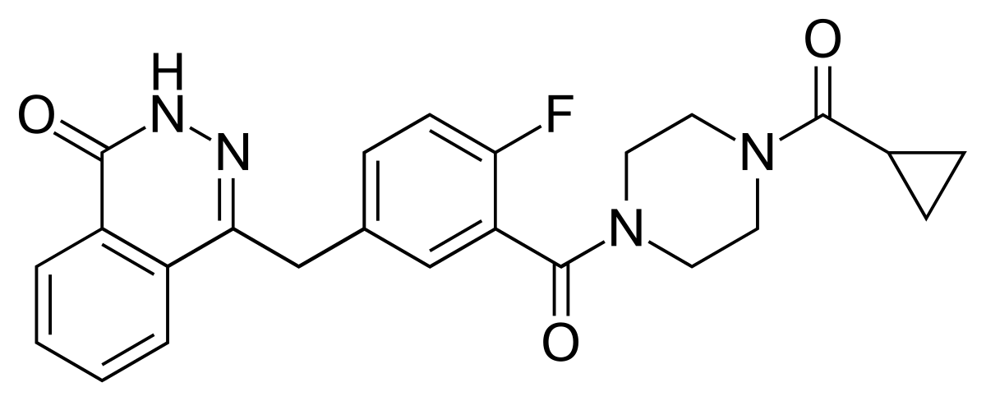
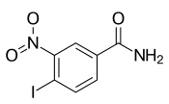
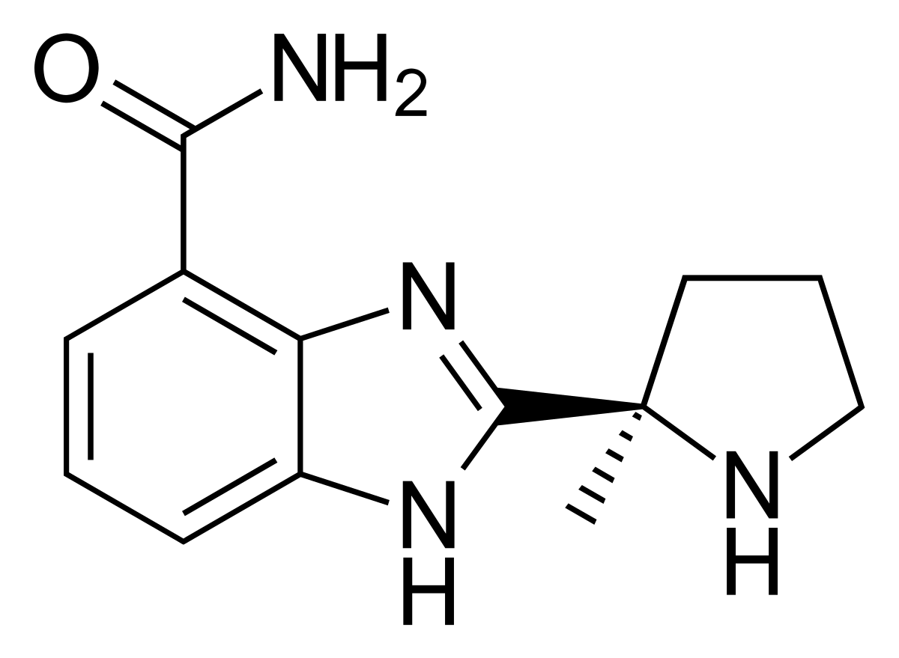
PARP inhibitors
Olaparib
Oral poly (adenosine diphosphate–ribose) polymerase inhibitor
Median PFS: 7.0 months vs. 4.2 months in the olaparib group and standard therapy group respectively
ORR: 59.9% in the olaparib group and 28.8% in the standard therapy group
Iniparib
Also known as BSI 201, is a prodrug with a half-life 4-min
First dose of 2.8 mg/kg dose caused PARP inhibition in PBMCs by more than 50%
Veliparib
Potentiate the effects of TMZ, platinum agents, cyclophosphamide, and radiation
Statistically significant decreases in PAR were defined as 55% reduction in PBMCs and 95% in tumors
Subsequent dosing increased the amount of PARP inhibition to more than 80%.
Andrahennadi S, Sami A, Manna M, et al. Current Landscape of Targeted Therapy in Hormone Receptor-Positive and HER2-Negative Breast Cancer. Current Oncology. 2021 Jun;28(3):1803-22.
Chen A. PARP inhibitors: its role in treatment of cancer. Chinese journal of cancer. 2011 Jul;30(7):463.

Slide 17
TNBC
TNBC is by the absence of ER, PgR, and HER2.
Approximately 170,000 (12%-20%) are of the triple-negative (ER–/PR–/HER2–) phenotype
BRCA ½ mutation
PD-L1 positive
PD-L1 negative/
BRCA1/2 negative
PARP inhibitors
Olaparib Talazoparib
or
Chemotherapy
Platinum Agents
Carboplatin
Cisplatin
Atezolizumab plus
nab-paclitaxel
or
Pembrolizumab plus
chemotherapy
Previously treated with
anthracycline or taxanes
in the adjuvant setting
No Previous treatment
Anthracycline
or taxane
Capecitabine,
eribulin or
vinorelbine
Initial approach to treatment for TNBC
Wahba HA, El-Hadaad HA. Current approaches in treatment of triple-negative breast cancer. Cancer biology & medicine. 2015 Jun;12(2):106.
Adel NG. Current treatment landscape and emerging therapies for metastatic triple-negative breast cancer. The American journal of managed care. 2021 Apr 1;27(5 Suppl):S87-96.

Slide 18




Chemotherapy
Alkylating agents
  Drugs such as cyclophosphamide damage DNA by adding a chemical to it
  Platinum base alkylating agents contain a heavy metal that prevents cancer cell from dividing
Anthracyclines
Lead to cell death of both cancerous and non-cancerous cells by damaging and disrupting the making of DNA
Anti-metabolites
Prevent the building blocks of DNA being used
Microtubule inhibitors
Stop a cell from diving into two cells
NCCN guidelines. Available at: https://www.nccn.org/patients/guidelines/content/PDF/breast-invasive-patient.pdf

Slide 19




Radiotherapy
Release of tumor antigens, tumor DNA, cytokines, and chemokines
Innate intratumoral immunity
Adaptive response
Radiotherapy
Indications of palliative radiotherapy in metastatic breast cancer:
Hemostasis (Local RT to breast fungating mass)
Pain (Local RT to unresectable painful breast mass)
^{Painful bony mets}
Impending bone fractures ( prevent SRE)
^{Impending cord compression}
MDS: Metastatic Disease Survival
1. Jutzy J, Lemons JM, Luke JJ, et al. The evolution of radiation therapy in metastatic breast cancer: from local therapy to systemic agent. International journal of breast cancer. 2018 May 16;2018. 2. Steinauer K, Gross MW, Huang DJ, et al. Radiotherapy in patients with distant metastatic breast cancer. Radiation Oncology. 2014 Dec;9(1):1-8.

Slide 20

Surgical Treatment
Patients with primary distant metastatic breast cancer: Benefit from resection of the breast tumour.
Questionable role of local surgery in improving outcomes in mBC, however toilet/palliative mastectomy may have a role in improving symptoms.
Ruiterkamp J, Ernst MF. The role of surgery in metastatic breast cancer. European journal of cancer. 2011 Sep 1;47:S6-22.

Slide 21

Miscellaneous Therapies
Miscellaneous therapies
Miscellaneous therapies
Miscellaneous therapies
VEGF inhibitors
Fibroblast growth factor receptors
Immunotherapy
Patients with advanced HER2-negative BC
Potential target in women with HR + mBC
Immune checkpoint inhibitors have shown efficacy in triple negative breast cancer
Paclitaxel and bevacizumab
Phase 2 studies have evaluated their efficacy in advanced BC with modest benefit
Pembrolizumab
Andrahennadi S, Sami A, Manna M, et al. Current Landscape of Targeted Therapy in Hormone Receptor-Positive and HER2-Negative Breast Cancer. Current Oncology. 2021 Jun;28(3):1803-22.

Slide 22
NCG guidelines for Metastatic Breast Cancer
Biopsy
ER/PR positive her2 neg
Her 2 positive²⁰
TNBC¹⁹
Chemotherapy
+Her 2 targeted
therapy with¹⁸
HT in triple positive
Chemotherapy
Low burden of disease
Visceral crisis
Hormonal
Therapy (HT)^{10,11}
Chemotherapy¹³⁻¹⁷
CDK4/6
Inhibitors with HT¹² Fulvestrant Exemestane with Everolimus
Failure of HT
NCG guidelines. Available at: https://tmc.gov.in/ncg/docs/PDF/DraftGuidelines/Breast/NCG guidelines 2019 Breast.pdf

Slide 23
Summary
Despite advances in breast cancer screening, diagnosis, and treatment, nearly 12% of patients with a diagnosis of breast cancer eventually develop metastatic disease
The complexity, heterogeneity, and genomic instability of metastatic breast cancer cells make their evaluation and therapy a challenging process
The key goal in the treatment of metastatic breast cancer is to prolong survival, allowing for toxicity issues to be taken into account
A deeper understanding of the metastasis biology is key to developing better treatment strategies and achieving long-lasting therapeutic efficacies against breast cancer

Slide 24

[PALBACE] ® Summary of Product Information
GENERIC NAME: Palbociclib
PRESENTATION: Capsules in 75 mg, 100 mg and 125 mg.
INDICATION(s):
A] Women: Palbociclib is indicated for the treatment of hormone receptor (HR) positive, human epidermal growth factor receptor 2 (HER2) negative locally advanced or metastatic breast cancer: in combination with an aromatase inhibitor; in combination with fulvestrant in women who have received prior endocrine therapy. In pre- or perimenopausal women, the endocrine therapy should be combined with a luteinizing hormone releasing hormone (LHRH) agonist.
B] Men: Palbociclib is indicated for the treatment of hormone receptor (HR)-positive, human epidermal growth factor receptor 2 (HER2)-negative advanced or metastatic breast cancer in combination with: An aromatase inhibitor as initial endocrine-based therapy; fulvestrant in patients who have received prior therapy.
DOSAGE AND ADMINISTRATION: The recommended dose is 125 mg of palbociclib once daily for 21 consecutive days followed by 7 days off treatment (Schedule 3/1) to comprise a complete cycle of 28 days. The treatment with palbociclib should be continued as long as the patient is deriving clinical benefit from therapy or until unacceptable toxicity occurs. Aromatase Inhibitors and fulvestrant to be administered in accordance with their prescribing information. Treatment of pre/perimenopausal women with the combination of palbociclib should always be combined with an LHRH agonist. For men treated with the combination of palbociclib plus aromatase inhibitor therapy, treatment with an LHRH agonist may be considered. Management of some adverse reactions may require temporary dose interruptions/delays and/or dose reductions, or permanent discontinuation as per dose reduction schedules, viz., first dose reduction to 100 mg/day, second reduction to 75 mg/day. Treatment to be discontinued if further dose reduction is required. Complete blood count should be monitored prior to the start of palbociclib therapy and at the beginning of each cycle, as well as on Day 15 of the first 2 cycles, and as clinically indicated. For patients who experience a maximum of Grade 1 or 2 neutropenia in the first 6 cycles, complete blood counts for subsequent cycles should be monitored every 3 months, prior to the beginning of a cycle and as clinically indicated. Absolute neutrophil counts (ANC) of ≥1,000/mm3 and platelet counts of ≥50,000/mm3 are recommended to receive palbociclib. Dosing in special populations: Elderly: No dose adjustment is necessary in patients ≥65 years of age. Hepatic Impairment: No dose adjustment of palbociclib is required for patients with mild or moderate hepatic impairment (Child-Pugh classes A and B). For patients with severe hepatic impairment (Child-Pugh class C), the recommended dose of palbociclib is 75 mg once daily on Schedule 3/1. Renal Impairment: No dose adjustment of palbociclib is required for patients with mild, moderate, or severe renal impairment (creatinine clearance [CrCl] >15 mL/min). Insufficient data are available in patients requiring haemodialysis to provide any dose adjustment recommendation in this patient population. Paediatric Population: The safety and efficacy of palbociclib in children and adolescents ≤18 years of age have not been established.
CONTRAINDICATIONS: Hypersensitivity to the active substance (microcrystalline cellulose, lactose monohydrate, sodium starch glycolate, colloidal silicon dioxide, magnesium stearate, and hard gelatin capsule shells. The light orange, light orange/caramel and caramel opaque capsule shells contain gelatin, red iron oxide, yellow iron oxide, and titanium dioxide; and the printing ink contains shellac, titanium dioxide, ammonium hydroxide, propylene glycol and simethicone). Use of preparations containing St. John’s Wort.
WARNING AND PRECAUTIONS: Pre/perimenopausal women: Ovarian ablation or suppression with an LHRH agonist is mandatory when pre/perimenopausal women are administered palbociclib in combination with an aromatase inhibitor or fulvestrant. Critical visceral disease: The efficacy and safety of palbociclib have not been studied in patients with critical visceral disease. Haematological disorders: Dose interruption, dose reduction, or delay in starting treatment cycles is recommended for patients who develop Grade 3 or 4 neutropenia. Appropriate monitoring should be performed. Interstitial lung disease/pneumonitis: Severe, life-threatening, or fatal ILD and/or pneumonitis can occur in patients treated with palbociclib when taken in combination with endocrine therapy. Across clinical trials, 1.4% of palbociclib-treated patients had ILD/pneumonitis of any grade, 0.1% had Grade 3, and no Grade 4 or fatal cases were reported. Additional cases of ILD/pneumonitis have been observed in the post-marketing setting, with fatalities reported. Monitor patients for pulmonary symptoms indicative of ILD/pneumonitis (e.g. hypoxia, cough, dyspnoea). In patients who have new or worsening respiratory symptoms and are suspected to have developed ILD/pneumonitis, interrupt palbociclib immediately and evaluate the patient. Permanently discontinue palbociclib in patients with severe ILD or pneumonitis. Infections: Since palbociclib has myelosuppressive properties, it may predispose patients to infections. Infections have been reported at a higher rate in patients treated with palbociclib in randomised clinical studies compared to patients treated in the respective comparator arm. Grades 3 and 4 infections occurred respectively in 5.6% and 0.9% of patients treated with palbociclib in any combination. Patients should be monitored for signs and symptoms of infection and treated as medically appropriate.Venous thromboembolic events were reported in patients treated with PALBACE. Patients should be monitored for signs and symptoms of deep vein thrombosis and pulmonary embolism and treated as medically appropriate. Physicians should inform patients to promptly report any episode of fever. Hepatic impairment: Administer palbociclib with caution to patients with moderate or severe hepatic impairment, with close monitoring of toxicity signs. Renal impairment: Administer palbociclib with caution to patients with moderate or severe renal impairment, with close monitoring of signs of toxicity. Concomitant treatment with inhibitors or inducers of CYP3A4: Strong inhibitors of CYP3A4 may lead to increased toxicity. Concomitant use of strong CYP3A inhibitors during treatment with palbociclib should be avoided. Co-administration should only be considered after careful evaluation of the potential benefits and risks. If co-administration with a strong CYP3A inhibitor is unavoidable, reduce the palbociclib dose to 75 mg once daily. When the strong inhibitor is discontinued, increase the palbociclib dose (after 3 5 half lives of the inhibitor) to the dose used prior to the initiation of the strong CYP3A inhibitor. Co-administration of CYP3A inducers may lead to decreased palbociclib exposure and consequently a risk for lack of efficacy. Therefore, concomitant use of palbociclib with strong CYP3A4 inducers should be avoided. No dose adjustments are required for co-administration of palbociclib with moderate CYP3A inducers.
Women of childbearing potential or their partners: Women of childbearing potential or their male partners must use a highly effective method of contraception while taking palbociclib. Lactose: This medicinal product contains lactose. Patients with rare hereditary problems of galactose intolerance, the Lapp lactase deficiency, or glucose-galactose malabsorption should not take this medicine.
Use in Special population: Women of childbearing potential/Contraception in males and females: Females of childbearing potential who are receiving this medicinal product, or their male partners should use adequate contraceptive methods (e.g., double-barrier contraception) during therapy and for at least 3 weeks or 14 weeks after completing therapy for females and males, respectively. Pregnancy: There are no or limited amount of data from the use of palbociclib in pregnant women. Studies in animals have shown reproductive toxicity. Palbociclib is not recommended during pregnancy and in women of childbearing potential not using contraception. Breast-feeding: No studies have been conducted in humans or animals to assess the effect of palbociclib on milk production, its presence in breast milk, or its effects on the breast-fed child. It is unknown whether palbociclib is excreted in human milk. Patients receiving palbociclib should not breast feed. Fertility: There were no effects on oestrous cycle (female rats) or mating and fertility in rats (male or female) in non-clinical reproductive studies. However, no clinical data have been obtained on fertility in humans. Based on male reproductive organ findings (seminiferous tubule degeneration in testis, epididymal hypospermia, lower sperm motility and density, and decreased prostate secretion) in non-clinical safety studies, male fertility may be compromised by treatment with palbociclib. Thus, men may consider sperm preservation prior to beginning therapy with palbociclib.
DRUG INTERACTIONS: Palbociclib is primarily metabolised by CYP3A and sulphotransferase (SULT) enzyme SULT2A1. In vivo, palbociclib is a weak, time-dependent inhibitor of CYP3A. Effect of CYP3A inhibitors: The concomitant use of strong CYP3A inhibitors including, but not limited to: clarithromycin, indinavir, itraconazole, ketoconazole, lopinavir/ritonavir, nefazodone, nelfinavir, posaconazole, saquinavir, telaprevir, telithromycin, voriconazole, and grapefruit or grapefruit juice, should be avoided. No dose adjustments are needed for mild and moderate CYP3A inhibitors. Effect of CYP3A inducers: The concomitant use of strong CYP3A inducers including, but not limited to: carbamazepine, enzalutamide, phenytoin, rifampin, and St. John’s Wort should be avoided. No dose adjustments are required for moderate CYP3A inducers. Effect of acid reducing agents: given the effect of proton pump inhibitors on palbociclib AUCinf and Cmax in fasting and fed conditions, palbociclib should be taken with food, preferably a meal. Given the reduced effect on gastric pH of H2-receptor antagonists and local antacids compared to PPIs, no clinically relevant effect of H2 receptor antagonists or local antacids on palbociclib exposure is expected when palbociclib is taken with food. Effects of palbociclib on the pharmacokinetics of other medicinal products: Palbociclib is a weak, time-dependent inhibitor of CYP3A. The dose of sensitive CYP3A substrates with a narrow therapeutic index (e.g., alfentanil, cyclosporine, dihydroergotamine, ergotamine, everolimus, fentanyl, pimozide, quinidine, sirolimus, and tacrolimus) may need to be reduced when co-administered with palbociclib as palbociclib may increase their exposure. Drug-drug interaction between palbociclib and letrozole: Data from the drug-drug interaction (DDI) evaluation portion of a clinical study in patients with breast cancer showed that there was no drug interaction between palbociclib and letrozole when the 2 medicinal products were co-administered. Effect of tamoxifen on palbociclib exposure: Data from a DDI study in healthy male subjects indicated that palbociclib exposures were comparable when a single dose of palbociclib was co-administered with multiple doses of tamoxifen and when palbociclib was given alone. Drug-drug interaction between palbociclib and fulvestrant: Data from a clinical study in patients with breast cancer showed that there was no clinically relevant drug interaction between palbociclib and fulvestrant when the two medicinal products were co-administered. Drug-drug interaction between palbociclib and oral contraceptives: DDI studies of palbociclib with oral contraceptives have not been conducted. In vitro studies with transporters: Based on in vitro data, palbociclib is predicted to inhibit intestinal P-glycoprotein (P-gp) and breast cancer resistance protein (BCRP) mediated transport. Therefore, administration of palbociclib with medicinal products that are substrates of P-gp (e.g., digoxin, dabigatran, colchicine) or BCRP (e.g., pravastatin, rosuvastatin, sulfasalazine) may increase their therapeutic effect and adverse reactions. Based on in vitro data, palbociclib may inhibit the uptake transporter organic cationic transporter OCT1 and then may increase the exposure of medical product substrates of this transporter (e.g., metformin).
OVERDOSE: In the event of a palbociclib overdose, both gastrointestinal (e.g., nausea, vomiting) and haematological (e.g., neutropenia) toxicity may occur and general supportive care should be provided.
ADVERSE REACTION: The most common adverse reactions of any grade reported in patients receiving palbociclib in randomised clinical studies were neutropenia, infections, leukopenia, fatigue, nausea, vomiting, stomatitis, anaemia, diarrhoea, alopecia, thrombocytopenia, asthenia, pyrexia, rash, dry skin. The most common (≥2%) Grade ≥3 adverse reactions of palbociclib were neutropenia, leukopenia, infections, anaemia, aspartate aminotransferase (AST) increased, fatigue, and alanine aminotransferase (ALT) increased. Common adverse events include febrile neutropenia, dysgeusia, epistaxis, ILD/pneumonitis, blurred vision, increased lacrimation, dry eye, Venous thromboembolism including pulmonary embolism, embolism, deep vein thrombosis, peripheral embolism, thrombosis & Palmar-plantar erythrodysaesthesia syndrome.
Uncommon AE, cutaneous lupus erythematosus was reported.
PHARMACEUTICAL PRECAUTIONS: Store below 30°C in the original package. No special requirements.
REFERENCE: LPDPAB062023 June-2023
DATE OF THIS DOCUMENT: 31 Aug 2023
Trademark Proprietor: Pfizer Inc., USA
Licensed User: Pfizer Products India Private Limited, India
GCMA - PP-UNP-IND-0214 02-11-2023
For the use only of Registered Medical Practitioners or a Hospital or a Laboratory
Full prescribing information available on request
Pfizer Products India Pvt Ltd, The Capital, B Wing 1802, 18th Floor, Plot No. C-70, G Block, Bandra Kurla Complex, Bandra (East), Mumbai 400051, India

