Slide 1
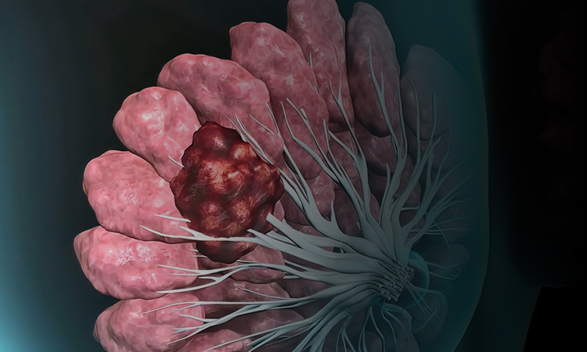

- Breast Cancer Awareness
Management of Early Breast Cancer
PP-UNP-IND-0213, 02-11-2023

Slide 2
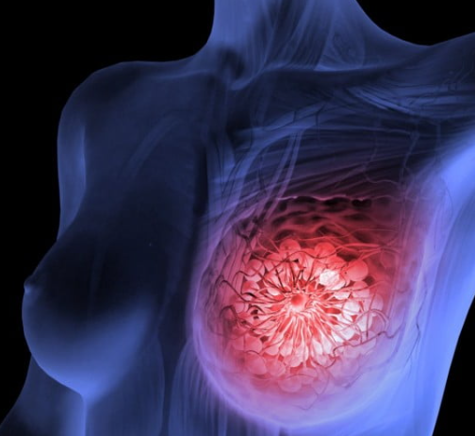
Breast Cancer
Most common cancer accounting for more than 1 in 10 new cancer diagnoses each year.¹
Second most common cause of death from cancer among women in the world.² Breast cancer alone accounts for 25% of all cancer cases and 15% of all cancer deaths among females.³
The incidence rate of breast cancer increases with age, from 1.5 cases per 100,000 in women 20 to 24 years of age to a peak of 421.3 cases per 100,000 in women 75 to 79 years of age.¹
1. Alkabban FM, Ferguson T. Cancer, breast. | 2. Ataollahi MR, Sharifi J, Paknahad MR, et al. Breast cancer and associated factors: a review. Journal of medicine and life. 2015;8(Spec Iss 4):6. | 3. Nounou MI, ElAmrawy F, Ahmed N, et al. Breast cancer: conventional diagnosis and treatment modalities and recent patents and technologies. Breast cancer: basic and clinical research. 2015 Jan;9:BCBCR-S29420.

Slide 3
Principles of systemic therapy in early breast cancer
Luminal-like
(ER or PgR positive, or both;
HER2 negative)
Triple negative
(ER and PgR and
HER2 negative)
HER2
positive
Lymph node involvement; grade; Ki67; Multigene signature or uPA/PAI-1 test
Offer BRCA testing (also without
family history- in case of
therapeutic consequences)
Luminal A or Low
Risk (only in pN0-1)
Luminal B or high
Risk (always in pN2-3)
Indication for chemotherapy if tumour stage ≥ T1b NO: preferably neoadjuvant
Endocrine Therapy
Chemotherapy
- endocrine therapy
Anthracycline & taxane containing chemotherapy (offer to add neoadjuvant platinum)
Chemotherapy + trastuzumab (and pertuzumab)* ±
endocrine therapy
Nadia Harbeck et al; Lancet Oncology; Breast cancer seminar; VOLUME 389, ISSUE 10074, P1134-1150, MARCH 18, 2017

Slide 4


Diagnosis of Breast Cancer
Tests and procedure used to diagnose Breast cancer include :
Mammogram
1
Breast Ultrasound
2
Biopsy
3
Breast Cancer Diagnosis - National Breast Cancer Foundation [Internet]. National Breast Cancer Foundation. 2021 [cited 3 June 2021]. Available from: https://www.nationalbreastcancer.org/breast-cancer-diagnosis/

Slide 5






Tests to diagnose metastatic breast cancer (MBC)
Bones and liver scans
Chest X-Ray
Computerized Tomography (CT) or Computerized Axial Tomography
Positron-Emission Tomography (PET) or PETCT scan
Magnetic Resonance Imaging
Blood test (including
markers of MBC)
Metastatic Breast Cancer Diagnosis | Young Survival Coalition | Young Survival Coalition [Internet]. Young Survival Coalition, Young women facing breast cancer together. 2021 [cited 9 July 2021]. Available from: https://www.youngsurvival.org/learn/about-breast-cancer/metastatic-breast-cancer-/metastatic-breast-cancer-diagnosis

Slide 6


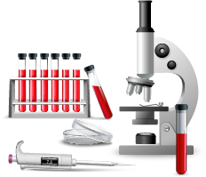
Lab Tests
Patients diagnosed with breast cancer may undergo additional lab tests to assist with prognosis. The two most common lab tests are the hormone receptor test and the human epidermal growth factor receptor 2 (HER2)/neu test.
Hormone Receptor Test
HER2/neu Test
Blood testing for HER2/neu
ImmunoHistoChemistry (IHC) procedure is used to determine the presence of hormone receptor on breast tissue sample.
Breast cancer patients positive for both estrogen receptors and progesterone receptors respond well to hormone therapy and, have a better- prognosis for survival and a complete recovery vs. those who have no receptors present.
The HER2/neu test looks for HER2 proteins or gene.
IHC test determines whether there is excess HER2 protein in the cancerous cells.
The FISH test, the SPoT-Light HER2 CISH test and the Inform HER2 Dual ISH test examine if the cells contain too many copies of the HER2 gene.
Breast cancers with HER2 protein overexpression and HER2 gene amplification are called HER2-positive. This type of cancer grows and spreads faster and and has a higher likelihood of recurring vs HER2-negative breast cancer.
In case of unavailability of not enough tumor tissue, a blood sample is drawn to test HER2/neu. This blood test is called a “serum HER2/neu test.
This test can be used as part of the initial workup upon cancer diagnosis or to monitor the effectiveness of treatment.
If initially the level of serum HER2/neu is elevated to >15 ng/mL and then it falls, the treatment is likely working.
When all three of the tests come back negative for receptors for hormones (progesterone and estrogen) and negative for HER2, triple negative breast cancer may be the diagnosis.
Breast Cancer Diagnosis - National Breast Cancer Foundation [Internet]. National Breast Cancer Foundation. 2021 [cited 3 June 2021]. Available from: https://www.nationalbreastcancer.org/breast-cancer-diagnosis/ FISH: Fluorescence In Situ Hybridization, SPoT-Light HER2 CISH: Subtraction Probe Technology Chromogenic In Situ Hybridization, Inform HER2 Dual ISH : Inform Dual In Situ Hybridization

Slide 7





Types of Treatment
  Radiation Therapy
Endocrine
(Hormone)
Therapy
Targeted
Therapy
Surgery
Chemotherapy
Nounou MI, ElAmrawy F, Ahmed N, et al. Breast cancer: conventional diagnosis and treatment modalities and recent patents and technologies. Breast cancer: basic and clinical research. 2015 Jan;9:BCBCR-S29420. Sharma GN, Dave R, Sanadya J, et al. Various types and management of breast cancer: an overview. Journal of advanced pharmaceutical technology & research. 2010 Apr;1(2):109.

Slide 8

Early Breast Cancer
Chemotherapy allows down-staging of the tumor to facilitate surgery and gaining of prognostic information.
Further advances in radiotherapy, chemotherapy and targeted therapies have improved treatment.
The general practitioner (GP) has an important role at every stage of the patient’s breast cancer journey.
Oncoplastic Surgery
Surgery for the Axilla
Surgical
Advancement
Breast reconstruction
techniques
Heilat GB, Brennan ME, French J. Update on the management of early-stage breast cancer. Australian journal of general practice. 2019 Sep;48(9):604-8.

Slide 9
Early Breast Cancer Treatment Algorithm
Early Breast Cancer
Tumour ≤2 cm and/or optimal surgery feasibleª
with the exception of aggressive phenotypes^{b}
Tumour >2 cm or optimal surgery not feasible
& wish for breast conservation & breast conservation
Potentially feasible after downstaging
TNBC/HER2-positive tumours >2 cm &/or with
positive axilla regardless of feasibility of optimal surgery
No wish for breast conservation or
breast conservation not possible with the
exception of aggressive phenotypes^{b}
Systemic induction therapy^{c} [I, A]
Satisfactory response
Unsatisfactory response
Breast-conserving surgery [I, A]
Mastectomy ± reconstruction [I, A]
Postoperative ChT ± anti-HER2
if applicable [I,A]
Postoperative RT^{d} if applicable
(mandatory after BCS) [I. A]
Postoperative ET^{d}
if applicable [I, A]
Cardoso F, Kyriakides S, Ohno S, et al. Early breast cancer: ESMO Clinical Practice Guidelines for diagnosis, treatment and follow-up. Annals of Oncology. 2019 Aug 1;30(8):1194-220.

Slide 10
HER2-positive Breast Cancer Treatment
HER2-positive Breast Cancer
Pre-operative ChT + trastuzumab ± pertuzumab
pCR
No pCR
Initially N-positive
or ER-negative
Other Cases
Complete 1 year of dual
blockade [I, A; MCBS B]ª or
Complete 1 year of
trastuzumab [I, A]
Complete 1 year of
trastuzumab [I, A]
T-DMI (I,A)^{b}
Cardoso F, Kyriakides S, Ohno S, et al. Early breast cancer: ESMO Clinical Practice Guidelines for diagnosis, treatment and follow-up. Annals of Oncology. 2019 Aug 1;30(8):1194-220.

Slide 11
Systematic Treatment recommendations For early breast cancer subtypes
Subtype | Recommended therapy | Comments
Luminal A-like | ET alone in the majority of cases | Consider ChT if high tumour burden (≥ 4 LNs, T3 or higher)
Luminal B-like (HER2-negative) | ChT followed by ET for the majority of cases
Luminal B-like (HER2-positive) | ChT + anti-HER2 followed by ET for all patients | If contraindications for the use of ChT, one may consider ET + anti-HER2 therapy, although no randomised data exist
HER2-positive (non-luminal) | ChT + anti-HER2
Triple-negative (ductal) | ChT
Cardoso F, Kyriakides S, Ohno S, et al. Early breast cancer: ESMO Clinical Practice Guidelines for diagnosis, treatment and follow-up. Annals of Oncology. 2019 Aug 1;30(8):1194-220.

Slide 12
Neoadjuvant or Preoperative Chemotherapy
Neoadjuvant chemotherapy might be given to try to shrink the tumor so that it can be removed with less extensive surgery
Tumor
down - staged
NEOADJUVANT CT
SURGERY
ADJUVANT CT
Tumor large for
Surgery
Adapted from Hyder T, Bhattacharya S, Gade K, et al. Approaching Neoadjuvant Therapy in the Management of Early-Stage Breast Cancer. Breast Cancer: Targets and Therapy. 2021;13:199. Miller E, Lee HJ, Lulla A, et al. Current treatment of early breast cancer: adjuvant and neoadjuvant therapy. F1000Research. 2014;3. Heilat GB, Brennan ME, French J. Update on the management of early-stage breast cancer. Australian journal of general practice. 2019 Sep;48(9):604-8.

Slide 13
Goals
Goals of treatment
Surgical downstaging of the tumor
Rendering inoperable
tumors resectable
De-escalating axillary surgery
Hyder T, Bhattacharya S, Gade K, et al. Approaching Neoadjuvant Therapy in the Management of Early-Stage Breast Cancer. Breast Cancer: Targets and Therapy. 2021;13:199. Miller E, Lee HJ, Lulla A, et al. Current treatment of early breast cancer: adjuvant and neoadjuvant therapy. F1000Research. 2014;3. Heilat GB, Brennan ME, French J. Update on the management of early-stage breast cancer. Australian journal of general practice. 2019 Sep;48(9):604-8.

Slide 14
Indications for consideration of Neoadjuvant Chemotherapy
*Hormone-receptor positive breast cancer
High-risk HER2-positive breast cancer
High-risk triple negative breast cancer
Inflammatory Breast cancer
Locally advanced tumors breast cancers
Clinically node-positive breast cancers
Patients with contraindications to surgery including pregnancy or venous thromboembolism (VTE)
Delayed elective surgical plans due to pandemic or other elective procedures
Note : *In certain circumstances
Hyder T, Bhattacharya S, Gade K, et al. Approaching Neoadjuvant Therapy in the Management of Early-Stage Breast Cancer. Breast Cancer: Targets and Therapy. 2021;13:199.

Slide 15

Neoadjuvant Chemotherapy
Considered for women with clinical stage IIA and IIB tumors with a larger tumor who wish to have breast-conserving operations and avoid mastectomy.
Has prognostic significance.
Tumor shrinkage reduces the need for mastectomy and for axillary lymph node dissection
Allows time for genetic testing and surgical planning in the setting of a strong family history
Allows more options for breast reconstruction when mastectomy is required.
*Image for representation purpose only
Hyder T, Bhattacharya S, Gade K, et al. Approaching Neoadjuvant Therapy in the Management of Early-Stage Breast Cancer. Breast Cancer: Targets and Therapy. 2021;13:199. Miller E, Lee HJ, Lulla A, et al. Current treatment of early breast cancer: adjuvant and neoadjuvant therapy. F1000Research. 2014;3. Heilat GB, Brennan ME, French J. Update on the management of early-stage breast cancer. Australian journal of general practice. 2019 Sep;48(9):604-8

Slide 16

Neoadjuvant treatment in patients with hormone receptor-positive
HER2-negative tumours
HER2-positive or TNBC : effect is most pronounced
In the neoadjuvant setting, understanding resistance mechanisms is of particular clinical relevance
HR+/HER2 - tumors : interaction is less evident
Stickeler E, Aktas B, Behrens A, et al. Update Breast Cancer 2021 Part 1–Prevention and Early Stages. Geburtshilfe und Frauenheilkunde. 2021 May 3;74.

Slide 17
Neoadjuvant Chemotherapy
No residual cancer
During subsequent
Surgery
Pathological
Complete response
(pCR)
Survival
Significantly
improved
NACT given
Likelihood of a pCR is highest for tumors that are oestrogen, progesterone and HER2-receptor negative (triple negative) or are HER2 positive.
These features on a diagnostic core biopsy : NACT is likely to be considered even for a small tumor.
Hyder T, Bhattacharya S, Gade K, et al. Approaching Neoadjuvant Therapy in the Management of Early-Stage Breast Cancer. Breast Cancer: Targets and Therapy. 2021;13:199. Miller E, Lee HJ, Lulla A, et al. Current treatment of early breast cancer: adjuvant and neoadjuvant therapy. F1000Research. 2014;3. Heilat GB, Brennan ME, French J. Update on the management of early-stage breast cancer. Australian journal of general practice. 2019 Sep;48(9):604-8.

Slide 18

Neoadjuvant Targeted therapy
Acts on specific molecular targets
HER 2 directed therapy. Example: Pertuzumab, Trastuzumab
CDK4/6 i
*Image for representation purpose only

Slide 19
Adjuvant Chemotherapy
Chemotherapy administered after definitive treatment of primary tumor by surgery and/or radiation.
The intent is curative
Acknowledges the presence of distant micro-metastases at diagnosis
Reduces risk of relapse/recurrence
Examples – EC/AC/CMF/Pacli (+/- trastuzumab)
Surgery
ADJUVANT CT
Tumor
Adapted from Jesus Anampa et al; progress in adjuvant chemotherapy for breast cancer; BMC Medicine (2015) 13:195

Slide 20
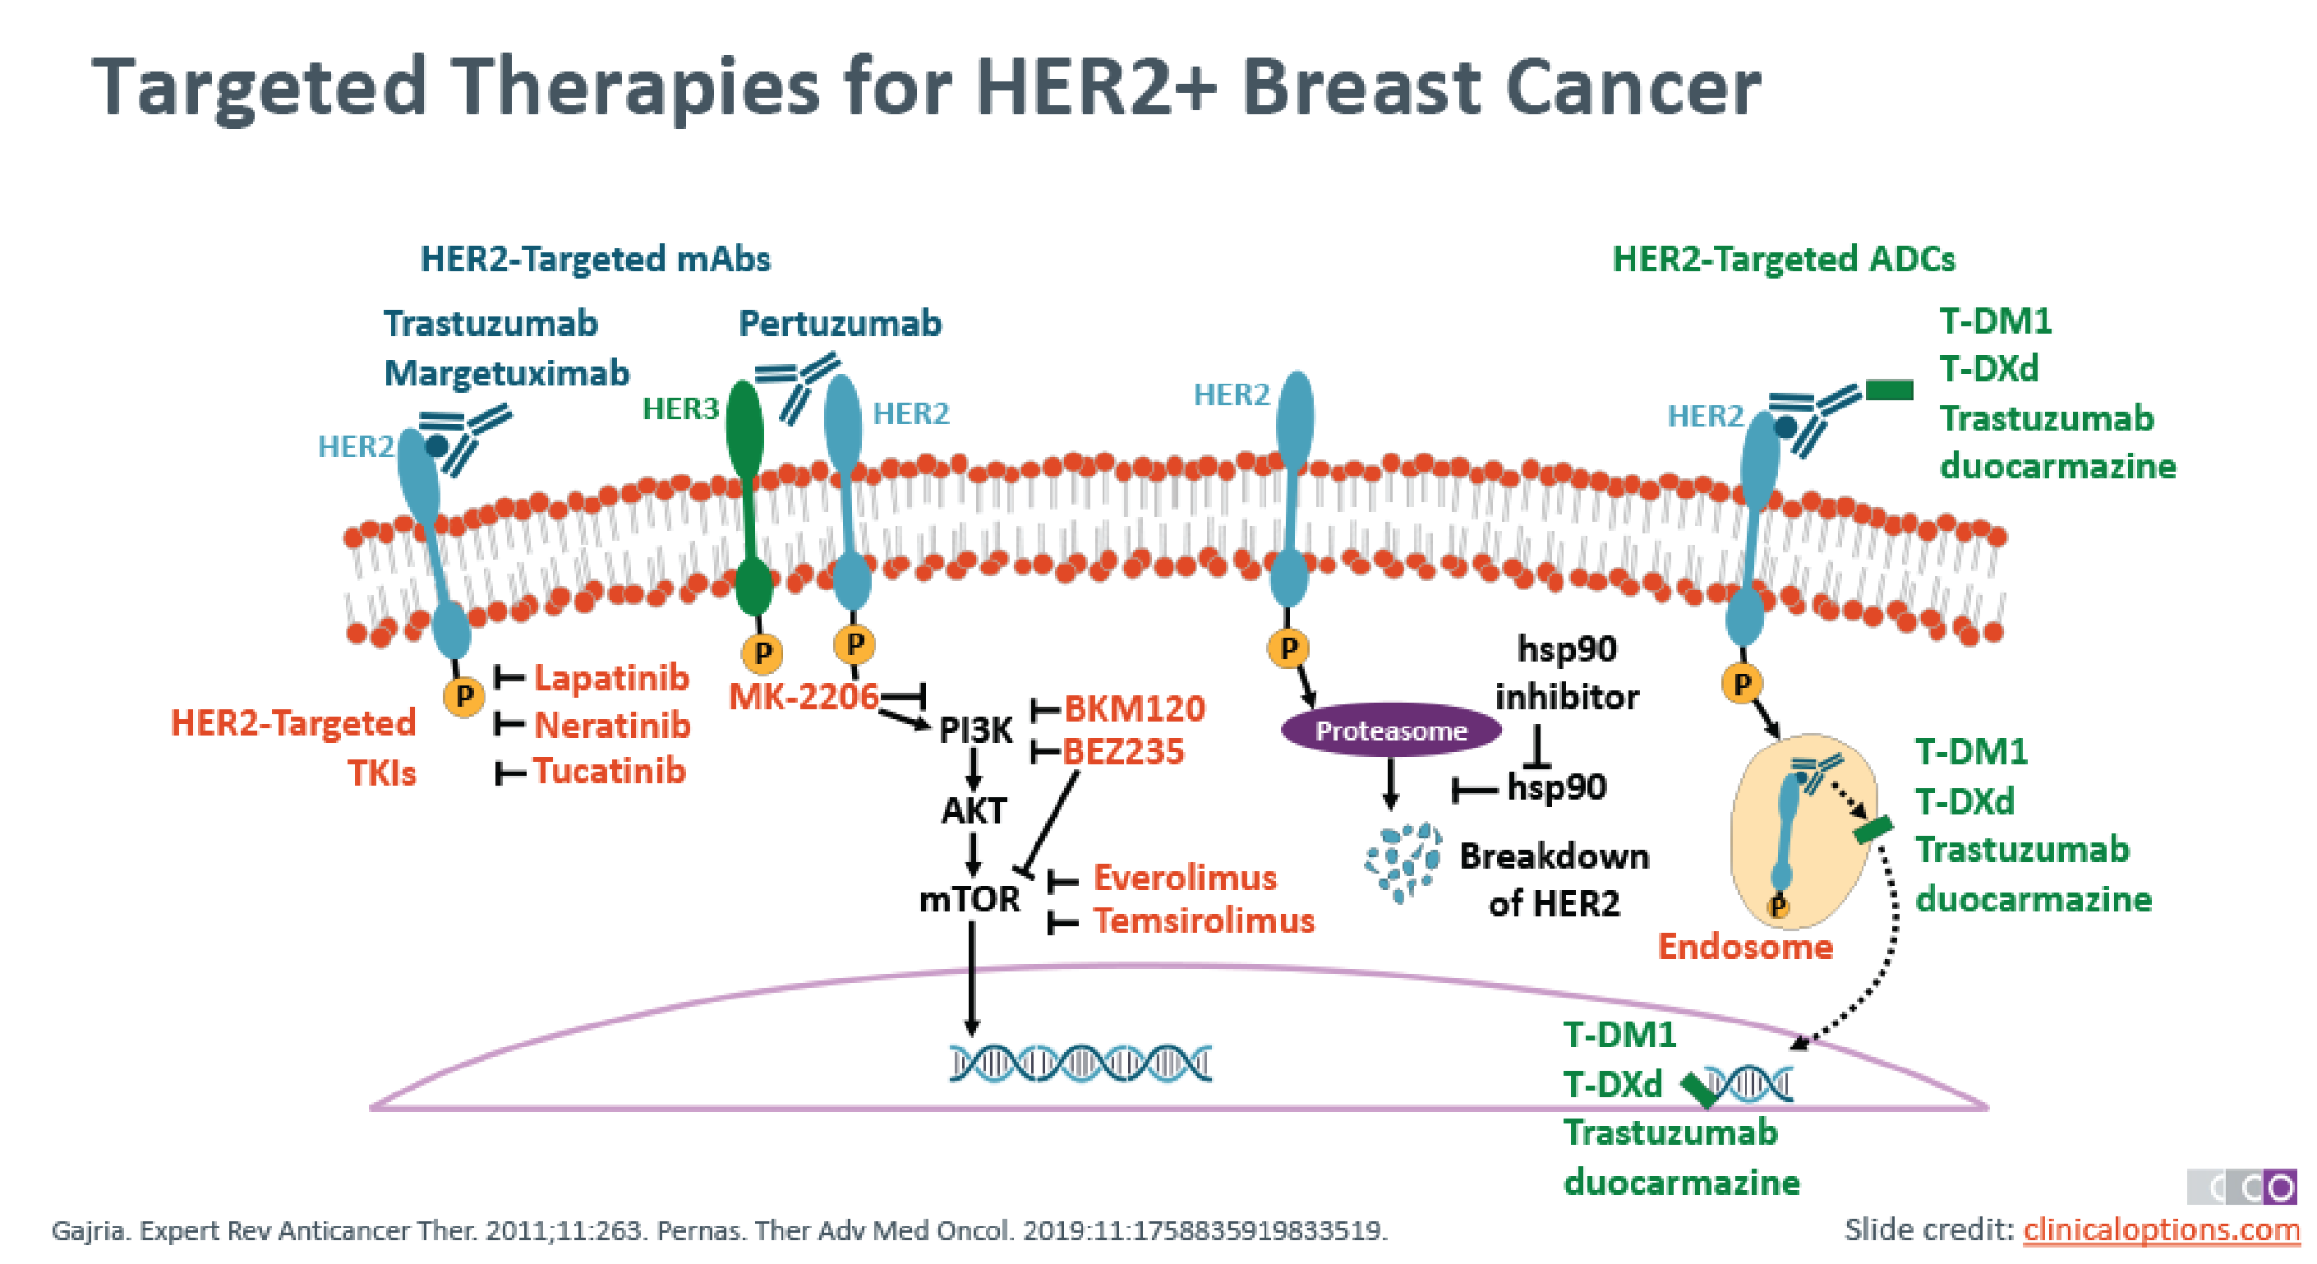
Adjuvant Targeted Therapy- HER 2 directed
First and only targeted agent approved for the adjuvant treatment of early-stage HER2-positive breast cancer
Trastuzumab
Binds to the extracellular domain of HER2
Suppress it’s signaling activity
Inducing antibody-dependent cell-mediated cytotoxicity
Targeted drug therapy uses medicines that are directed at (target) proteins on breast cancer cells that help them grow, spread, and live longer.
Targeted drugs work to destroy cancer cells or slow down their growth
Brown-Glaberman U, Dayao Z, Royce M. HER2-targeted therapy for early-stage breast cancer: a comprehensive review. Oncology. 2014 Apr 1;28(4):281-.

Slide 21

Surgery for Breast Cancer
Often the sole treatment in the management of early-stage breast cancer¹
Surgery may be done to
Types
Remove as much of the cancer as possible
Find out whether the cancer has spread to the lymph nodes under the arm
Breast-conserving surgery
Only the part of the breast containing the cancer is removed
Mastectomy
Entire breast is removed
Restore the breast’s shape after the cancer is removed
Relieve symptoms of advanced cancer
1. Czajka ML, Pfeifer C. Breast Cancer Surgery Breast Cancer Surgery. Available at: https://www.cancer.org/cancer/breast-cancer/treatment/surgery-for-breast-cancer.html

Slide 22

Surgery
Breast-conserving surgery is indicated in all patients in stage I and II of the disease & tumor measured up to 3.5 cm regardless of the axillary lymph nodes status
Neoadjuvant therapy
Shrink tumor bulk
Breast conservation surgery
Treatment of localized breast cancer
Adjuvant therapy
Full recovery and minimize the risk of metastases
Mitov FS, Molov VV. Breast-conserving surgery in early-stage breast cancer (indications, local recurrences, survival, cosmetic results). Folia medica. 2006 Jan 1;48(1):23-30. Nounou MI, ElAmrawy F, Ahmed N, et al. Breast cancer: conventional diagnosis and treatment modalities and recent patents and technologies. Breast cancer: basic and clinical research. 2015 Jan;9:BCBCR-S29420.

Slide 23
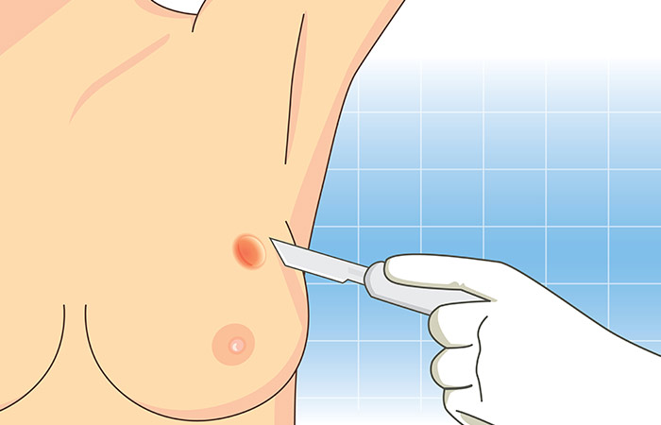
Mastectomy and breast-conserving therapy
A total of 23,810 breast cancer patients were included, of whom 44.9% received BCT and 55.1% underwent mastectomy, with a median follow-up of 116 months
BCT group had improved breast cancer-specific survival and overall survival as compared to mastectomy group
The survival benefit of BCT was more pronounced in the slightly older (36–40 years) group
Sun ZH, Chen C, Kuang XW, et al. Breast surgery for young women with early-stage breast cancer: Mastectomy or breast-conserving therapy?. Medicine. 2021 May 7;100(18).

Slide 24




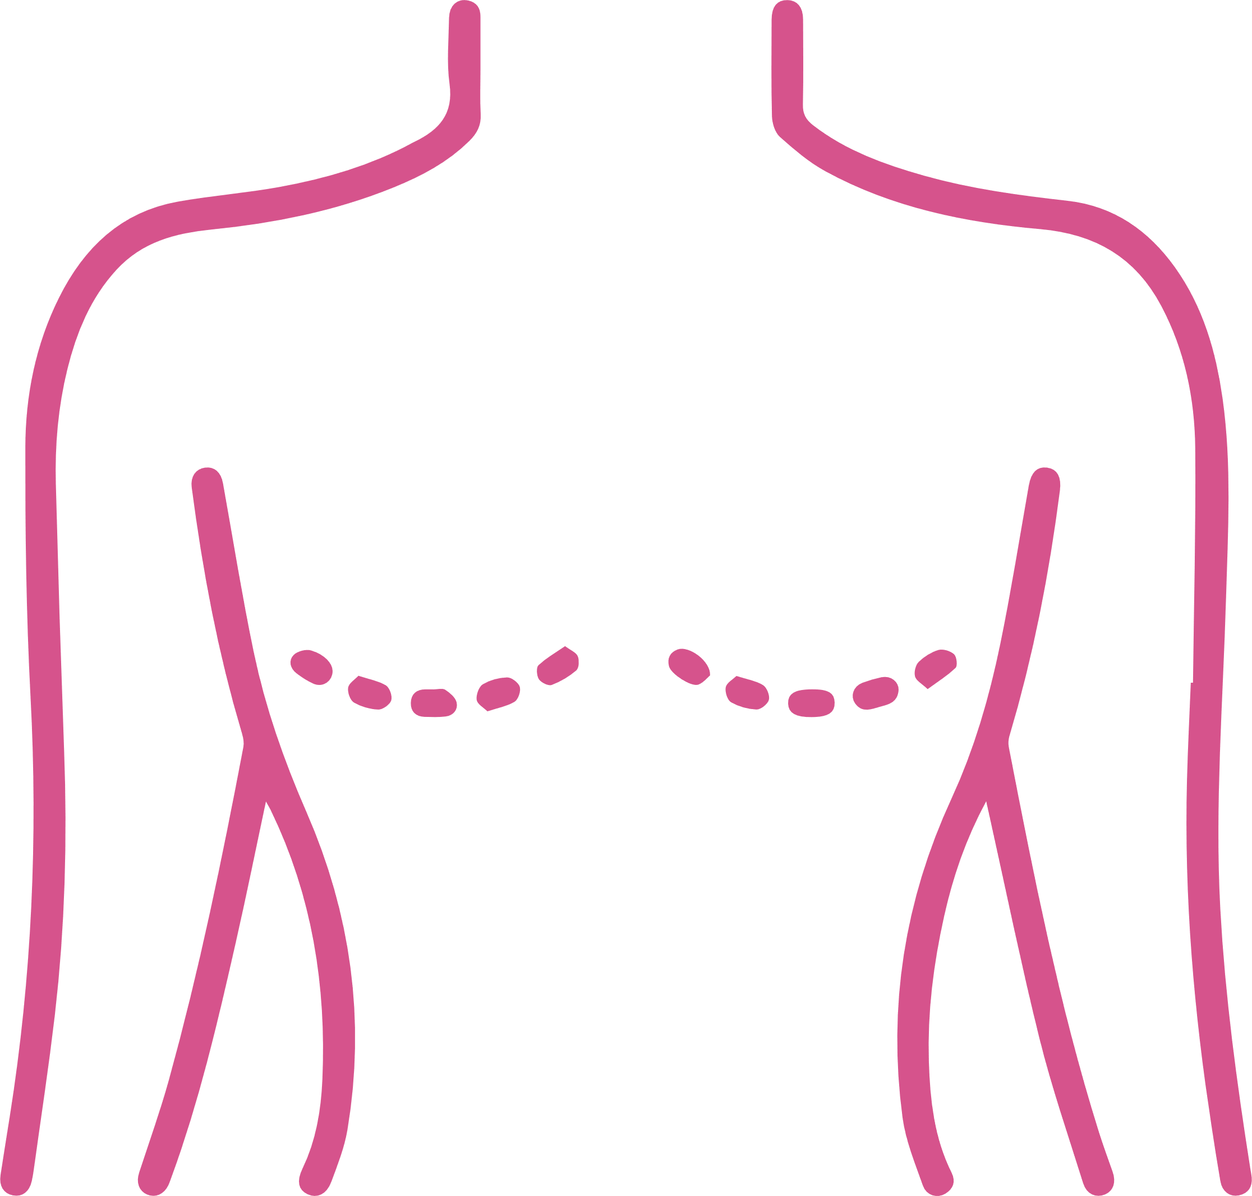
Survival of Breast-Conserving Surgery Plus Radiotherapy versus Total Mastectomy
45,770 EBC
patients
Korean Breast
Cancer Registry
BCS + RT: OS- 1.541
BCSS- 1.405
TM
Asian Medical Center
BCS + RT: OS- 1.854
BCSS- 1.807
BCS + RT
BCS + RT is at least equivalent to TM in terms of OS and may affect treatment decisions in early breast cancer patients
BCS: Breast-conserving surgery, RT: Radiotherapy, TM: Total mastectomy, EBC: Early breast cancer.
Kim H, Lee SB, Nam SJ, et al. Survival of Breast-Conserving Surgery Plus Radiotherapy versus Total Mastectomy in Early Breast Cancer. Annals of surgical oncology. 2021 Jan 25:1-9.

Slide 25
Hormonal/Endocrine therapy
Key to the remarkable
advances in endocrine
therapy
Identification of the estrogen receptor (ER) as the mechanism and catalyst
ER represents a critical growth and survival pathway in breast tumors. Blocking the ER with an antiestrogen is selectively toxic to the tumor
Hussain SA, Williams S, Stevens A, et al. Endocrine therapy for early breast cancer. Expert review of anticancer therapy. 2004 Oct 1;4(5):877-88.

Slide 26

Hormonal/Endocrine therapy
Tamoxifen
Aromatase inhibitors
The Early Breast Cancer Trialists collaborative group analyzed 55 randomized trials involving 37,000 women
Positive impact of tamoxifen therapy was seen in women with ER-positive breast cancer, and in women who received 5 years of therapy as compared with those having shorter duration.
Anastrozole demonstrated equivalence to tamoxifen in the primary end points of time to progression (TTP: 8.2 vs. 8.3 min) and overall response rate (ORR: 32.9 vs. 32.6%) within the TARGET study
The Intergroup Exemestane Study: Switching adjuvant endocrine therapy after 2-3 years tamoxifen to exemestane is associated with clinically relevant improvements in efficacy
Hussain SA, Williams S, Stevens A, et al. Endocrine therapy for early breast cancer. Expert review of anticancer therapy. 2004 Oct 1;4(5):877-88. Morden JP, Alvarez I, Bertelli G. et al. Long term follow-up of the Intergroup Exemestane Study (IES). Journal of clinical oncology: official journal of the American Society of Clinical Oncology. 2017 Aug 1;35(22):2507.

Slide 27

Radiotherapy
Established role in reducing the local relapses in breast cancer patients.
They are usually given 5 days a week during short appointments at a hospital or clinic
Standard radiation treatments are usually given over a period of 5 to 7 weeks. Another option is to have higher doses of radiation for about 3 week
Radiotherapy following mastectomy and / or breast-conserving surgery has a beneficial effect on survival.
Challenged: Treatment-related morbidity and limited radiotherapy resources.
Sanjeev Chandra J, FA K, Ishita P. Role of radiotherapy in early Breast Cancer: an overview. Radiation for Early Stage Breast Cancer. Available at: https://www.uofmhealth.org/health-library/abq5398

Slide 28

Summary
About 2.1 million newly diagnosed female breast cancer cases, accounting for almost one in four cancer cases among women, and ∼630 000 died of it
The choice of treatment strategy should be based on the tumour burden/location and biology as well as the age, menopausal status, general health status and preferences of the patient
ER, PgR and HER2 status are predictive factors to select patients for targeted ET or anti-HER2 treatment
Trademark Proprietor: Pfizer Inc., USA
Licensed User: Pfizer Products India Private Limited, India
GCMA - PP-UNP-IND-0213, 02-11-2023
Pfizer Products India Pvt Ltd, The Capital, B Wing 1802, 18th Floor, Plot No. C-70, G Block, Bandra Kurla Complex, Bandra (East), Mumbai 400051, India
For the use only of Registered Medical Practitioners or a Hospital or a Laboratory

